Slide 1
Launch of Towards 2020
GWP 2014-2019 Strategy

Slide 2
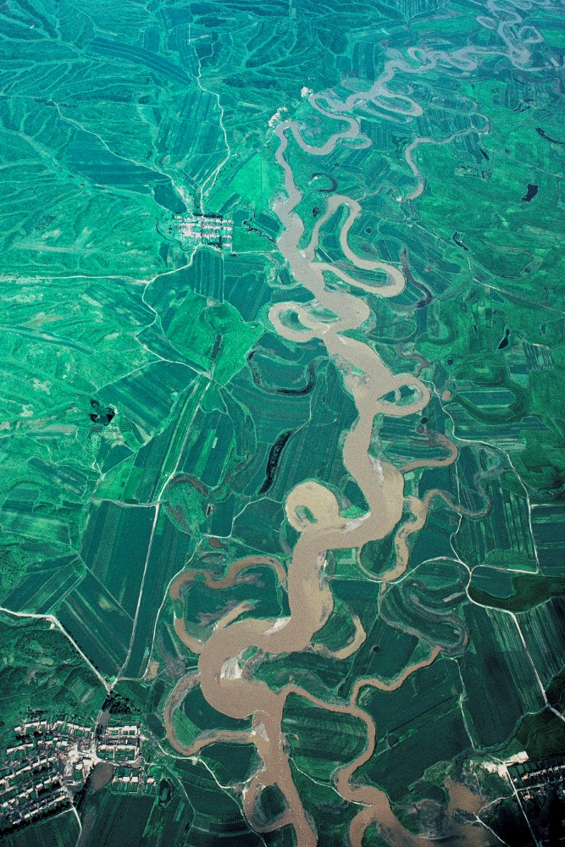
GWP Strategy Towards 2020
GWP Vision: A Water Secure World
GWP Mission: To advance governance and management of water resources for sustainable and equitable development.
GWP Core Values: Neutrality, inclusiveness, openness, integrity, accountability, respect, gender sensitivity, and solidarity
Notes:
GWP is internationally recognised as a leading advocate for the integrated development and management of water, land, and related resources in order to support
economic efficiency, social equity, and environmental sustainability – the three pillars of sustainable development.
Founded in 1996, GWP's network comprises 13 Regional Water Partnerships and 84 Country Water Partnerships, involving over 3,000 partner organisations in 172 countries.
GWP is at the forefront of helping countries to prepare and take full ownership of their plans for integrating water resources and services as a means for achieving water security. Our support moves beyond planning and into practice.
Our Guiding Principles reflect international understanding of the 'equitable and efficient management and sustainable use of water'. The guiding principles are:
Freshwater is a finite and vulnerable resource, essential to sustain life, development and the environment.
Water development and management should be based on a participatory approach involving users, planners and policy makers at all levels.
Women play a central part in the provision, management and safeguarding of water.
Water is a public good and has a social and economic value in all its competing uses.
Integrated water resources management is based on the equitable and efficient management and sustainable use of water and recognises that water is an integral part of the ecosystem, a natural resource, and a social and economic good, whose quantity and quality determine the nature of its utilisation.

Slide 3
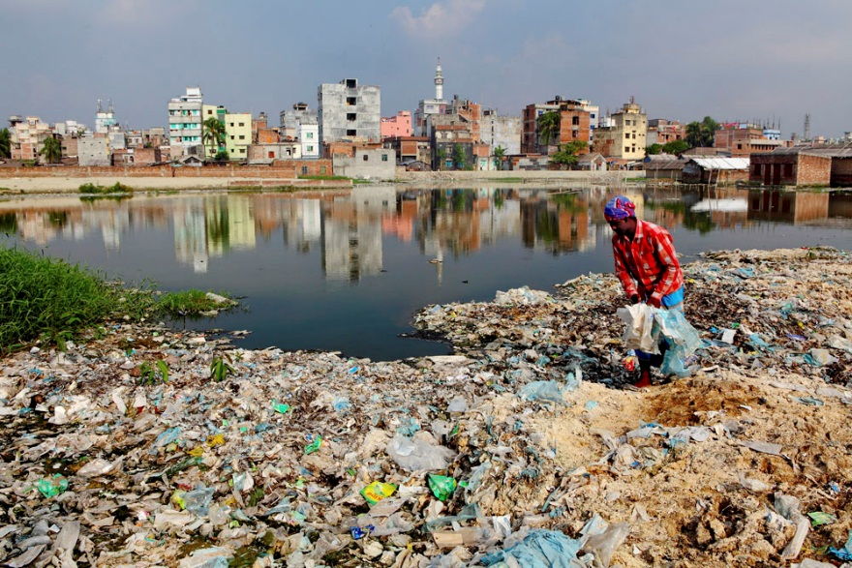
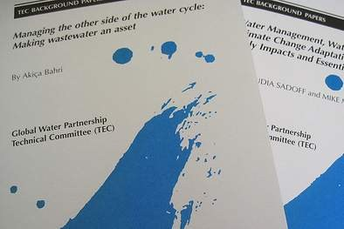
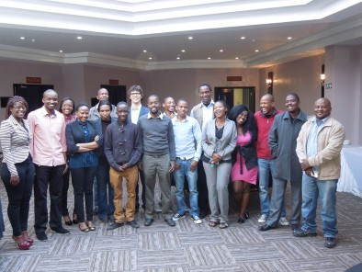
GWP Strategic Goals
1) Catalyse change in policies and practice
2) Generate and communicate knowledge
3) Strengthen partnerships
Notes:
The Strategic Goals for GWP over 2014-2019 build off of the last strategic period:
1) Catalyse change in policies and practice: advancing effective governance, based on comprehensive and mutually supportive policies, institutions, sound partnerships and processes, and information-sharing.
2) Generate and communicate knowledge: developing partners’ capacity to share knowledge and to foster a dynamic communications culture. We also strive to generate knowledge to improve the understanding of water security related challenges.
3) Strengthen partnerships: enhancing the viability and effectiveness of GWP’s network by strengthening partnerships and partner organisations to catalyse change, enhance learning, and improve financial sustainability.

Slide 4
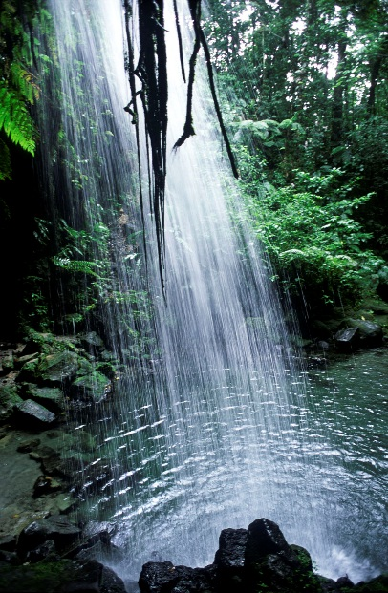
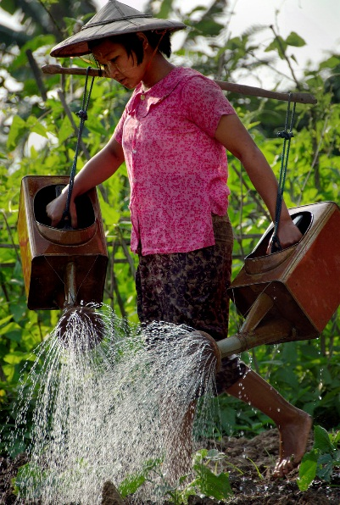
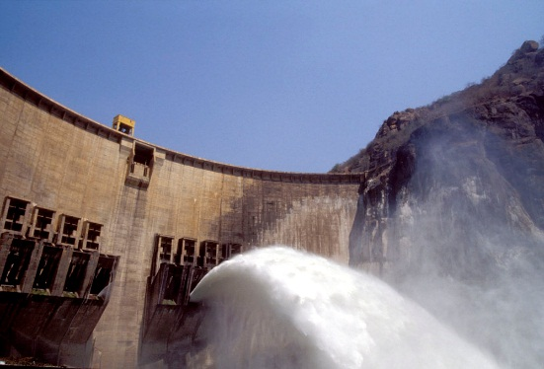
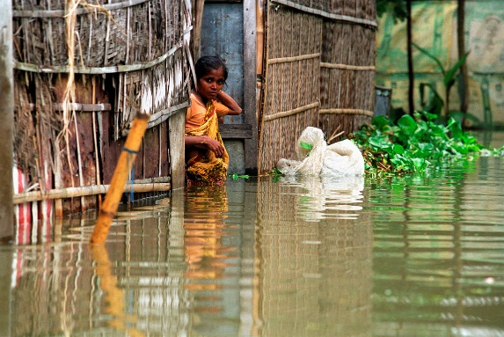
GWP Thematic Approach
Ecosystems
Food
Transboundary
Energy
Climate Change
Urbanisation
Notes:
Our new strategy takes a thematic approach to water security and supports programme implementation in six key areas of development – climate change, transboundary cooperation, food, urbanisation, energy, and ecosystems.
This approach is designed to integrate water security initiatives with development actions in each of the six thematic areas so that the global development agenda reflects the importance of water security for meeting human development goals.

Slide 5
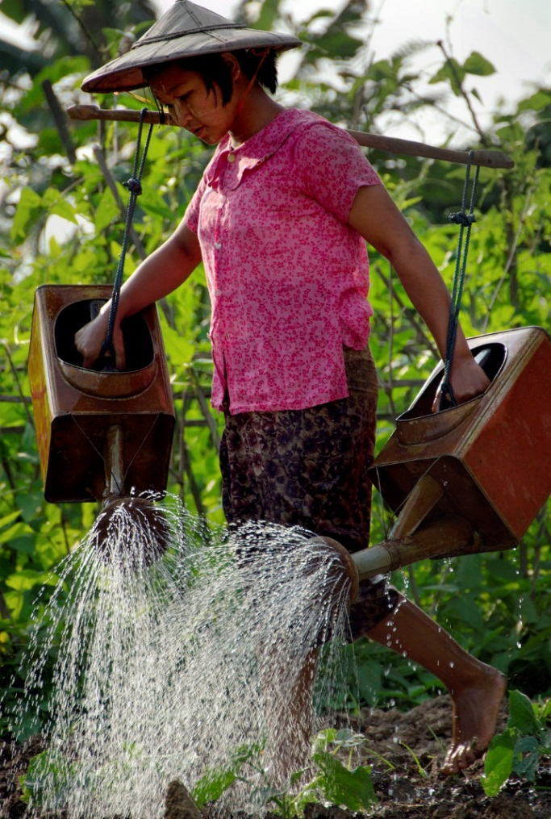
Cross Cutting Issues: Gender and Youth
Support for gender mainstreaming in water management
Support for youth and young water professionals
Independent gender and youth strategies under development
Notes:
Gender Equity: We actively support the Dublin Principle that women play a central role in providing, managing, and safeguarding water. Our gender strategy supports gender mainstreaming to ensure that the interests and needs of women and men are taken equally into account in water policymaking.
Youth Engagement: We encourage and support young people and youth organisations to be fully active and engaged in water partnerships and processes. Our youth strategy guides our partnerships with youth organisations and our work with young water professionals and entrepreneurs.
Both our Gender and Youth Strategies are under development and will help to enhance the roles of our gendder and youth focal points within our network, as well as link our gender-related and youth-related work to our broader strategy and theory for change.

Slide 6
Strategic Approach
Notes:
Though difficult to read, this diagram shows how all of the aspects of the GWP Strategy fit together.
Our vision of a water secure world and our mission are in the centre, at the hear of what we do.
Our strategic goals are our means of achieving this vision and mission
Gender and Youth are our cross cutting themes
And our new thematic approach is the outer layer

Slide 7
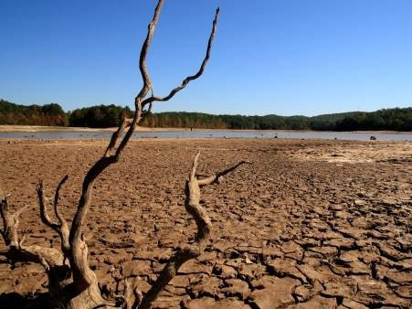
Delivering the Strategy
Strengthening Network
Capacity
Monitoring and Evaluation
Securing Financial Resources
Contributing to the Global
Development Agenda
Notes:
We will deliver this strategy through strengthening network capacity, rigorously monitoring and evaluating our work, securing new and sustainable financing modalities, and by contributing to the global development agenda.
Strengthening network capacity: Building the capacity of our network partners is a cornerstone of our strategy. We will continue to strengthen our organisational and governance structures in order to better respond to the challenges in delivering this strategy. We will deepen our skills in areas such as facilitation, mentoring, networking, and online media in order to support multi-stakeholder platforms that facilitate interaction and promote learning for change.
Monitoring and evaluation: We will apply rigorous monitoring and evaluation procedures to enable us to critically assess progress towards our goals. Our reporting structure and the results will enable us to undertake extensive analysis to enhance our learning and adaptive capacity and strengthen our organisational planning.
Securing financial resources: We will look for new funding sources and innovative financing modalities that enable us to invest in our people, our programmes, and our partners.
Contributing to the Global Development Agenda: Through our global reach and local actions, we will play an active role in the sustainable development agenda.

Slide 8
Join Us!
Check out the GWP Toolbox! An online repository that brings together resources on how to apply Integrated Water Resources Management: www.gwptoolbox.org
Become a Partner! Applications are open to all organization and institutions that support an integrated approach to managing water resources and there is no fee. Apply online at http://www.gwp.org
Notes:
The challenges of achieving a truly water secure world can only be overcome with the collaboration and support of all agencies working towards the same end. We invite you to join us in achieving this vision.

