Slide 1
GWP IWRM ToolBox: Overview

Slide 2
The IWRM ToolBox
Vision
The ToolBox will be an internet-based repository of all GWP knowledge on IWRM and the first choice site for water practitioners, decision-makers, and partners.
The ToolBox will contribute to establishing a global communication platform which develops capacity in IWRM and shares knowledge to improve the way water is managed.
Goal

Slide 3
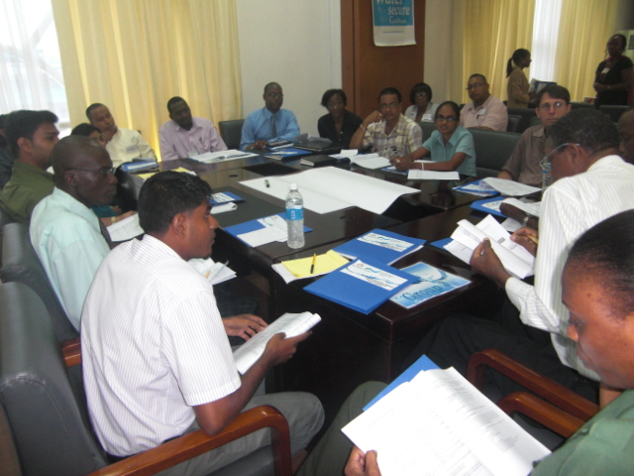
WHY was the GWP IWRM ToolBox was created?
We wanted to:
share existing knowledge on IWRM
create a platform for exchange of experience
describe a complex concept (IWRM)
capture real life stories on application of IWRM
highlight the best publications, organizations, and web links on IWRM

Slide 4
WHO is the ToolBox for?
Those who apply IWRM:
trainers
capacity-builders
practitioners
decision-makers
academia and researchers

Slide 5
WHAT is the ToolBox?
The IWRM ToolBox consists of knowledge (how to manage water) and learning (applying the knowledge):
Knowledge
Learning
60 Tools
References
Case Studies
the key concepts that have to be addressed in managing water
technical papers to training manuals to research documents to articles – an array of resources linked to specific Tools and Case Studies
show how the Tools work in real experiences from all over the world. They include successes and failures and share best practices.

Slide 6
60 tools

Slide 7
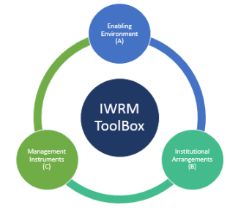
The Tools in the ToolBox
60 Tools
organized under three thematic areas of IWRM:
(A) Enabling Environment
(B) Institutional Arrangements
(C) Management Instruments

Slide 8
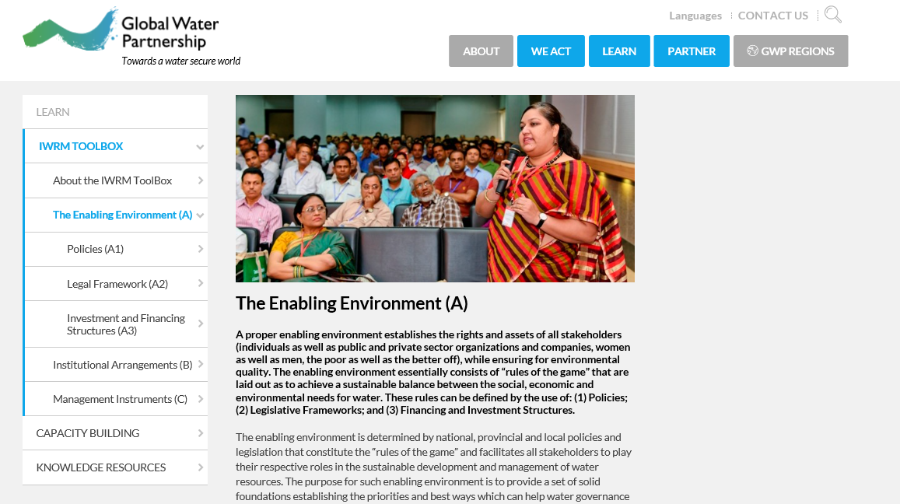
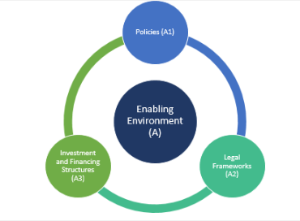
Tools: The Enabling Environment (A)

Slide 9
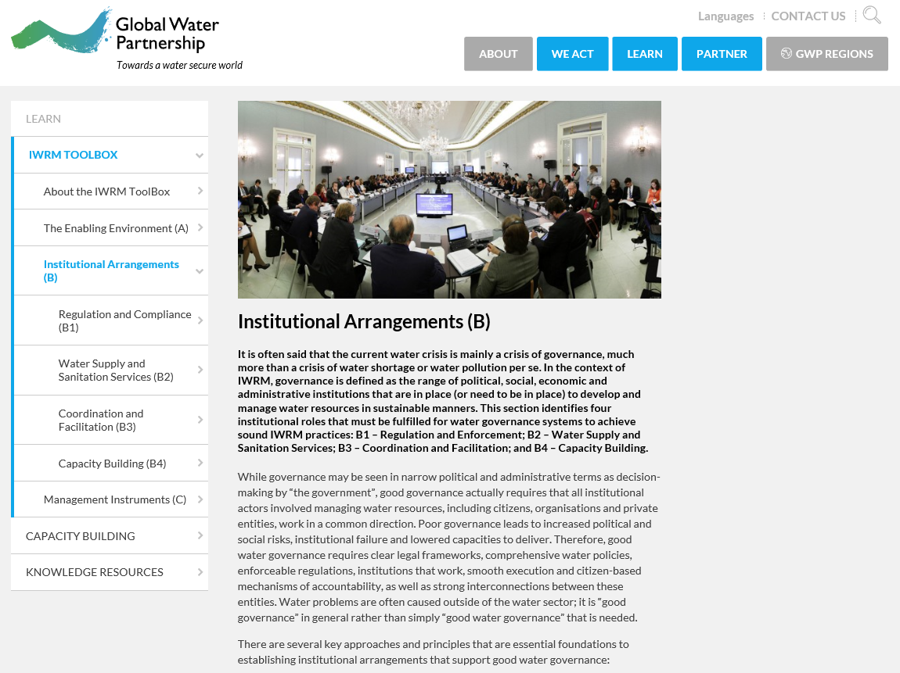
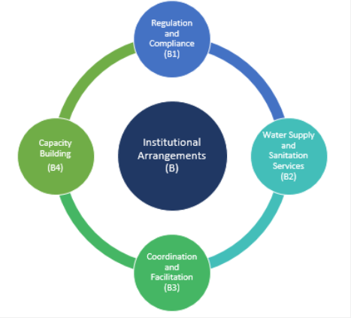
Tools: Institutional Arrangements (B)

Slide 10
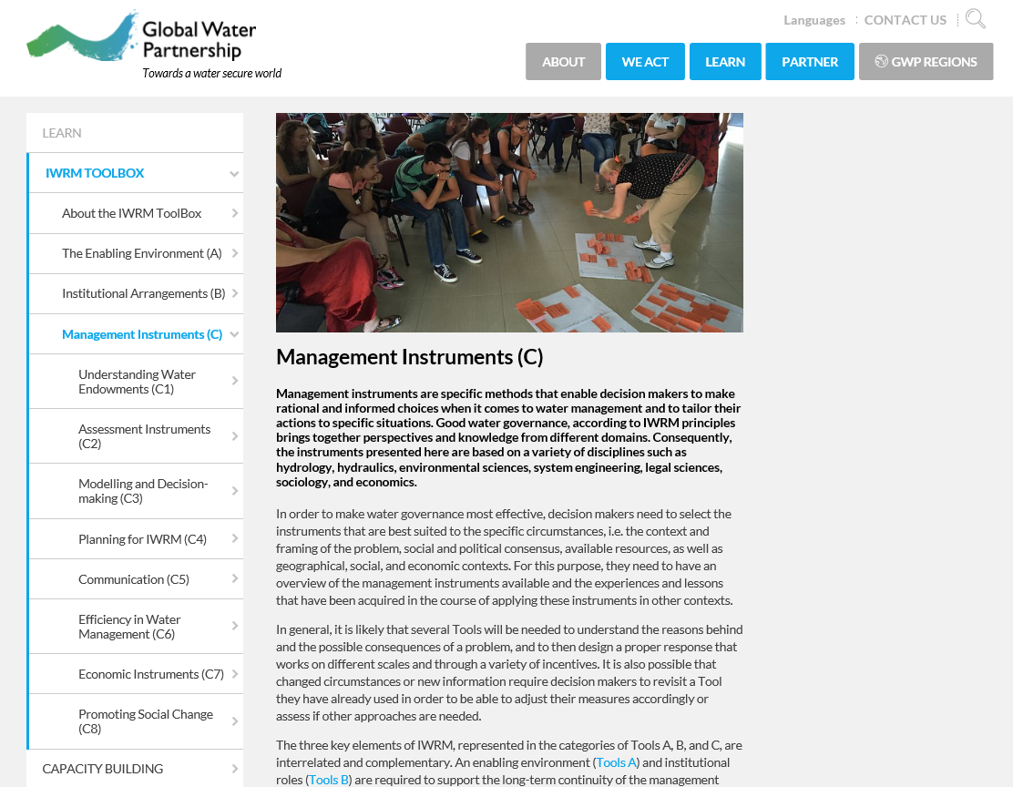
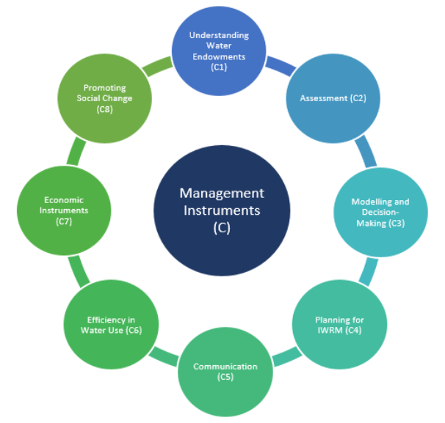
Tools: Management Instruments (C)

Slide 11
How to Use the Tools
Do: use a variety of Tools
Don’t: use all of the Tools. Rather, carefully evaluate and choose those which fit the context.
Do: consider how some Tools are pre-conditions to others, while others are complementary
Don’t: use the tools in isolation
Do: monitor and evaluate changes as tools are adopted, to prevent unintended or undesirable consquences
Remember: the Tools are not a panacea and good governance is a must!
The IWRM ToolBox is chronologically organized as if the user was to set up a water governance system from scratch. This, of course, only fits theoretical cases.
IWRM is not a step-by-step process to success; the practitioner and the policy maker has to select the relevant mix and sequence of tools that have the best chance of working in a specific community or country.

Slide 12
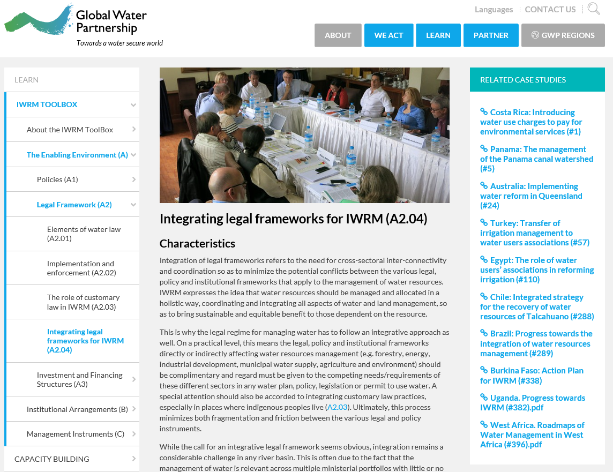
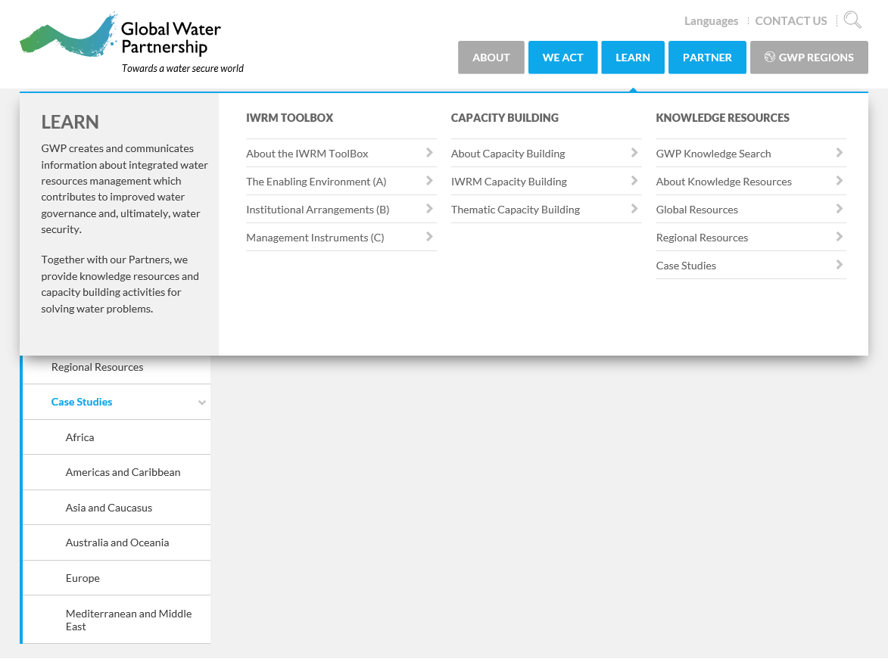
Case Studies in the ToolBox
Though the case studies are not explicitly within the IWRM Toolbox, each Tool has related case studies:
Case studies can also be accessed through Learn under Knowledge Resources, and are arranged into continents/regions:

Slide 13
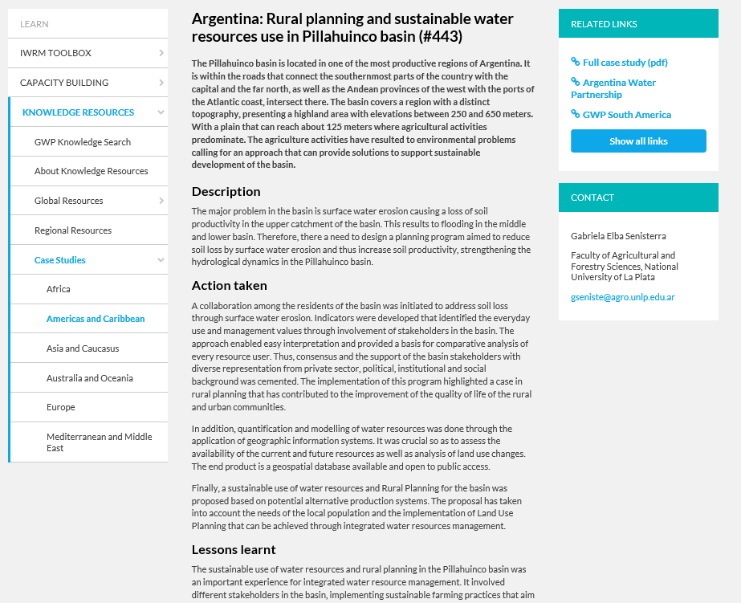
Case Studies in the ToolBox: an example
Each Case Study has:
Link to the full length case study
Contact information to learn more
1 page summary
Notes:
(J) Let’s look at one case study as an example of the contents you will find.
Each case study is presented on the GWP website as a 1 page summary including a brief description, the actions taken, and the lessons learnt.
If you want to read further and understand more details, there will always be a link to the full length case study on the right.
Of course, we would like to encourage you to apply these lessons in your own location. If you ever need to contact the author to for further discussion, contact information for each case study can also be found to the right of each case study summary page.

Slide 14
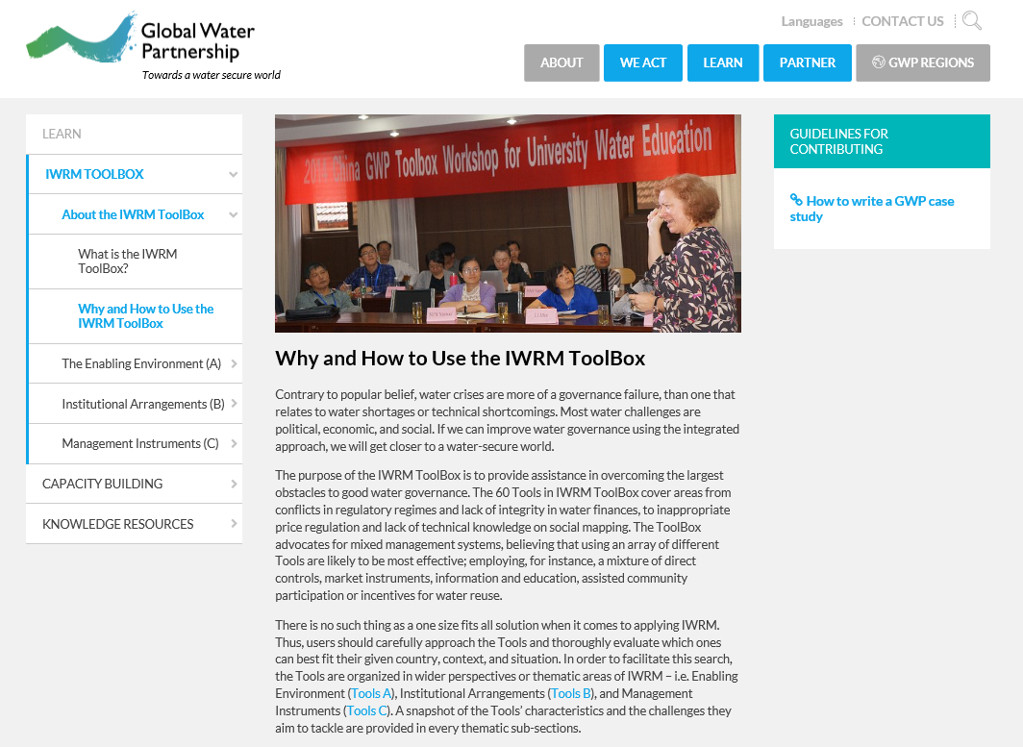
Case Studies in the ToolBox: Contributing
Do you have a case study to contribute?
Check out the guidelines
Submit a proposal!

Slide 15
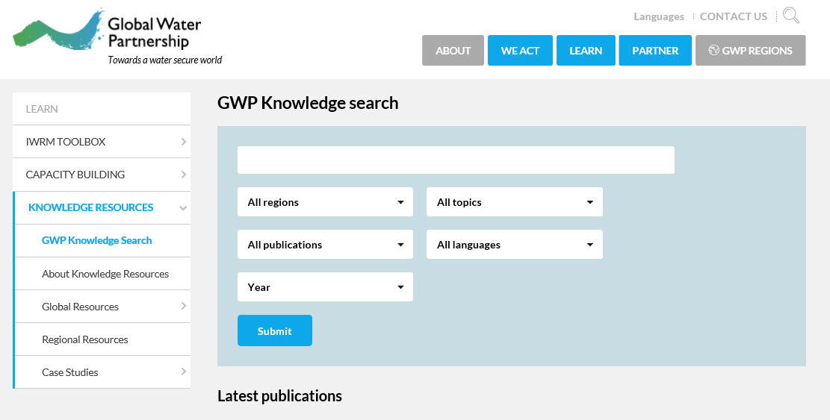
The GWP Knowledge Search
Looking for something specific? The Knowledge Search helps you find publications for exactly your needs.
Search by:
Key words
Region (13 regions, or global)
Topic (12 options)
Type of publication (16 options)
Language (11 languages)
Year published (2000-now)

Slide 16
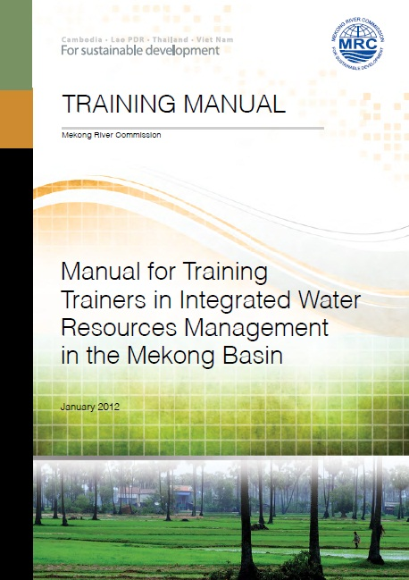
Examples of How the ToolBox Was Used
Example 1 - Teaching other water practicioners
Result: IWRM training manual for Mekong Basin
Directly uses tools and structure within the ToolBox
ToolBox publications were used as resources to support development of the manual
http://www.gwp.org/globalassets/global/toolbox/references/manual-for-training-trainers-in-iwrm-in-the-mekong-basin-mrc-2012.pdf

Slide 17
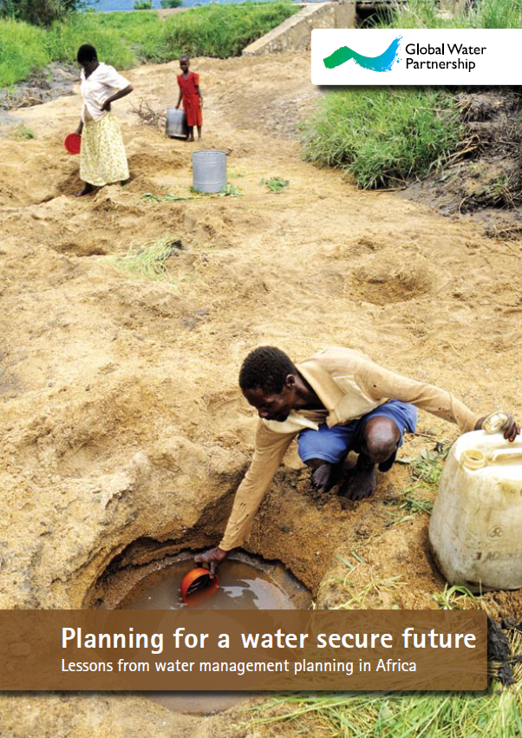
Examples of How the ToolBox Was Used
Example 2 - National water planning
Result: Applying participatory approach and IWRM in Kenya, Malawi, Mali, Senegal, and Zambia (Partnership for African’s Water Development)
ToolBox was a reference source to improve water governance
ToolBox provided a framework for analysis of the water resources situation
http://www.gwp.org/globalassets/global/toolbox/references/planning-for-a-water-secure-future-lessons-from-africa-gwp-2008.pdf

Slide 18
Thanks!
Questions? Contact gwp@gwp.org

