Slide 1
China’s Water Resources Management Challenge: The Three Redlines
E
Presented by Dajun Shen

Slide 2
Technical Focus Paper
China’s Water Resources Management Challenge: The Three Redlines
Authors:
Professor Dajun Shen, Renmin University of China
Dr. Yunzhong Jiang, China Institute of Water Resources and Hydropower Research
Dr. Sun Fu, Tsinghua University
Contributors:
Wouter Linckiaen Arriens, TEC Member
Liya Gu, Ministry of Water Resources, China
Rugang Zheng, GWP China
Melvyn Kay, GWP TEC-editor
Danka Thalmeinerova, GWP Secretariat

Slide 3
Purpose of the paper
To present how China, as a fast developing country, to deal with its water problems
Traditional and emerging water problems
Changing role of water resources in society and economy
New concepts and strategies
Comprehensive practices
To the water managers and regions facing and will face the similar water problems as those in China

Slide 4
Purpose of the paper
Structure of the paper
China’s Water Resources Challenge
Three redlines
What has been achieved so far?: the works coducted
conclusions
The paper is more descriptive, in order to present fresh, first-hand, real water resources management story in China

Slide 5
Water Resources Challenges
China’s water resources
Rich in total, less in per capita
Uneven temporal distribution: much more in summer and less in winter
Uneven spatial allocation, more in south, less in north; more in east and less in west.
Lower water use efficiency

Slide 6
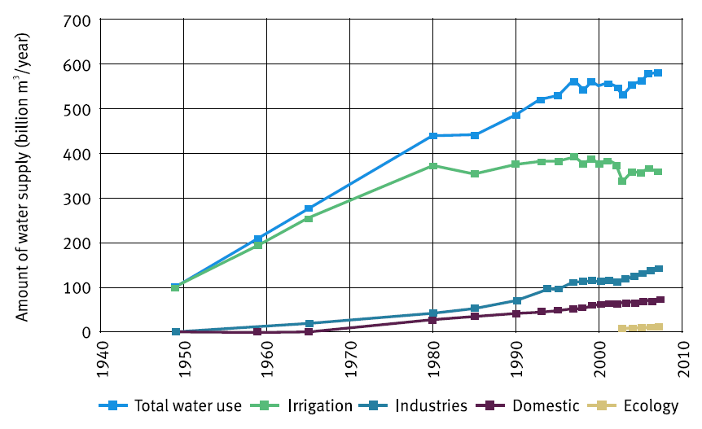
Water Resources Challenges
Fast increasing demand, exceeding supply

Slide 7
Water Resources Challenges
Severe water shortage

Slide 8
Water Resources Challenges
More water demand for growth and people
Economic development
Fast urbanization
Problems of efficiency and pollution control
Lower water use efficiency
Increasing industrial and domestic wastewater discharge
Lower water function zone rate meeting the required water quality
Ineffective water management
Poor water monitoring
Poor water administration
Lack of long-term funding for water management

Slide 9
Water Resources Challenges
Need for reform and an integrated approach
Better implementation of 2002 Water Law
Rural and urban coordination
Coordination of regional development
New approach to allocating water
Market-oriented
Water rights reform
New strategy for managing water
Establish stringent water resources management system
Safeguard safe drinking water and industrial water use
Establish an effective water allocation and use system
Establish an water resources protection system
Establish capacity, and science and technology support

Slide 10
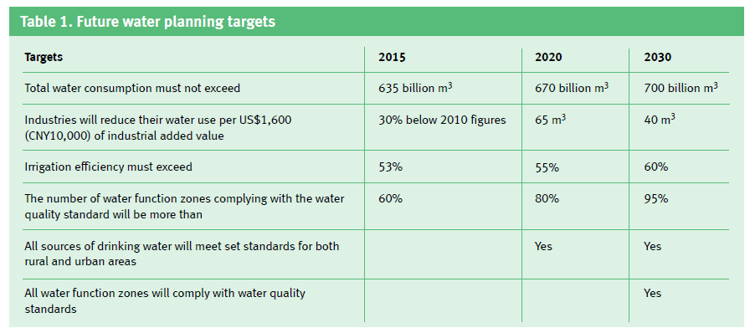
Achievements in IWRM in China: three red lines

Slide 11
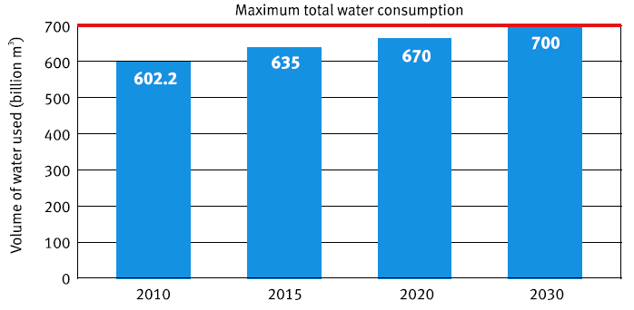
Achievements in IWRM in China: three red lines
A redline for total water use

Slide 12
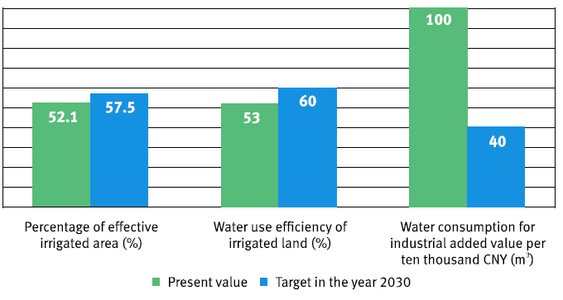
Achievements in IWRM in China: three red lines
A redline for water use efficiency

Slide 13
Achievements in IWRM in China: three red lines
A redline for controlling pollution

Slide 14
Achievements in IWRM in China: Main tasks
Controlling total water use
Planning and developing water resources
Controlling water abstraction
Improving water charges
Controlling groundwater abstraction
Taking an integrated approach
Improving water use efficiency
Reinforing efficient water use and management
Strengthening a quota management for water use
Developing a conservative and water-saving culture

Slide 15
Achievements in IWRM in China: Main tasks
Controlling pollution
Monitoring and managing water function zones
Protecting drinking water sources
Protecting and restoring ecosystems

Slide 16
Achievements in IWRM in China: achieved so far
Political and policy supports
2011 Accerating reform and development for the water sector
2012 Guildelines on implementing the stringent water resources management systms
2013 Regulation on assessment for implementing stringent water resources management systms
2014 Workplan for the assessment of the stringent water resources management systms
2014 Annoucement of the evaulation results for implementing stringent water resources management systms

Slide 17
Achievements in IWRM in China: achieved so far
Capacity building
Improving water-related laws and regulations
Reforming and integrating institutions
Building effective water management system
Long-term, stable investment mechanism
Scientific and technical support
Accountability and evaulation
A target-oriented responsibility system
Monitoring water use
A national water resource monitoring system

Slide 18
Achievements in IWRM in China: achieved so far
Pilot projects
Shandong Province
Hebei Province
Shanghai Municipality
Tianjin Municipality
Han Riverbasin
Zhangjiagang City
Yongkang City

Slide 19
Achievements in IWRM in China: Future development
Market plays a decisive role
Water rights reform
Water pricing reform

Slide 20
Key messages
Both water supply and water demand management, as solutions must bring these two into balance
Changes in planning, shifting the priority from development to conservation and protection
A change from tackling pollution problems after occurance to preventing them occurring in the first place
Changing pattern of water use from extensive use to efficient use
Changing managerial tools to integrated approach

Slide 21
Conclusions in the paper
Dealing with water resources challenges
Stringent water resources management systems
Three redlines
Policy framework
Pilot projects

Slide 22
Read the full paper here:
http://www.gwp.org/en/ToolBox/PUBLICATIONS/Technical-Focus-Papers/
Learn more about the GWP China:
www.gwpchina.org
For more knowledge products of GWP Technical Committee here:
http://www.gwp.org/en/ToolBox/PUBLICATIONS/

