Slide 1
IWRM in Central and Eastern Europe
IWRM vs EU Water Framework Directive
Presented by József Gayer

Slide 2
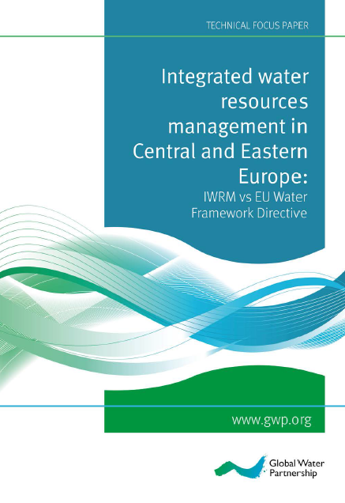
Technical Focus Paper
Integrated water resources management in Central and Eastern Europe: IWRM vs. EU Water Framework Directive
by
Janusz Kindler, István Ijjas and Danka Thalmeinerova
with contributions of the region’s CWPs

Slide 3
Purpose of the paper
Why? 25 years after political changes > EU accession and experiences with EU WFD;
17 years with GWP > experiences with IWRM
For whom? Decision makers and stakeholders able to influence them
Political will is needed!

Slide 4
IWRM in Central and Eastern Europe
Contents
CEE’s water challenges
Water policy challenges
Water resources management
IWRM vs EU WFD
IWRM experiences
Adopting IWRM – where are we?
Describing and analysing the situation/processes

Slide 5
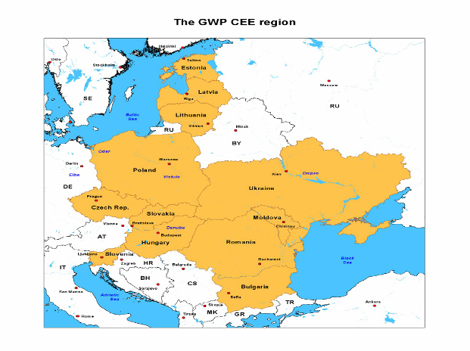
The GWP CEE region
GWP CEE
12 countries
11 languages
1.1 million km²
145 million inhabitants
Baltic sea (4):
several river basins
Black sea (7): dominated by the Danube River
(1) between
Different water resource management issues and priorities

Slide 6
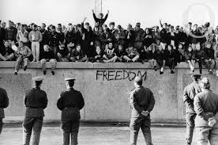
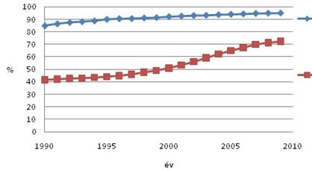
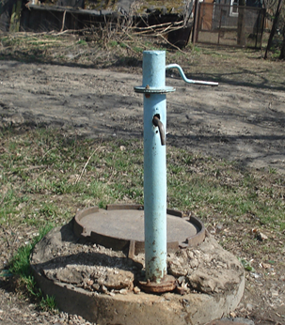
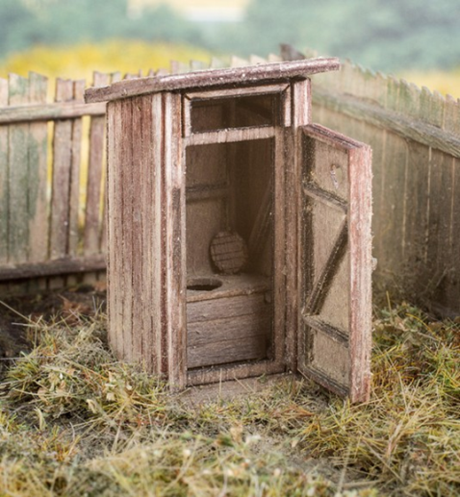
Water Resources Challenges 1/2
Political, economic and social transformation (w/o precedent), approaching EU, decentralisation
Water demand decreased
Drinking water and sanitation

Slide 7
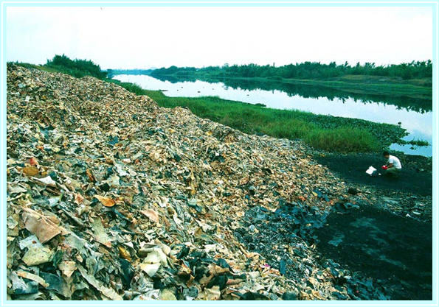
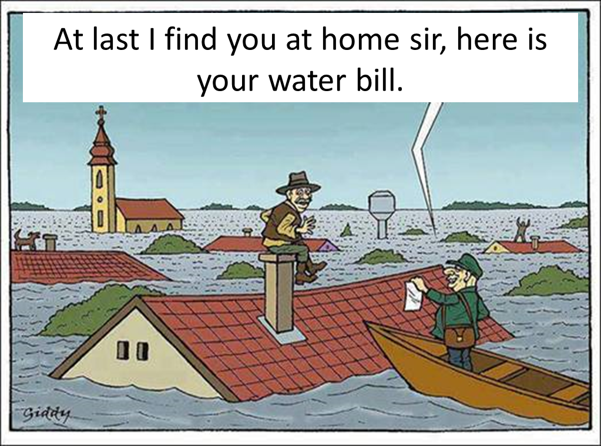
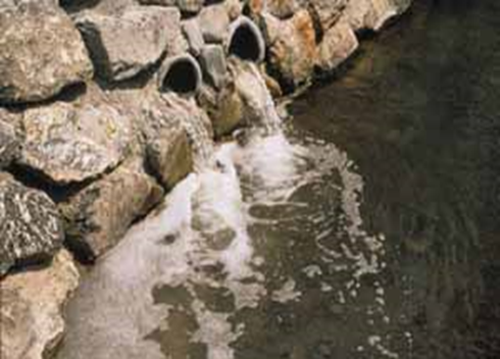
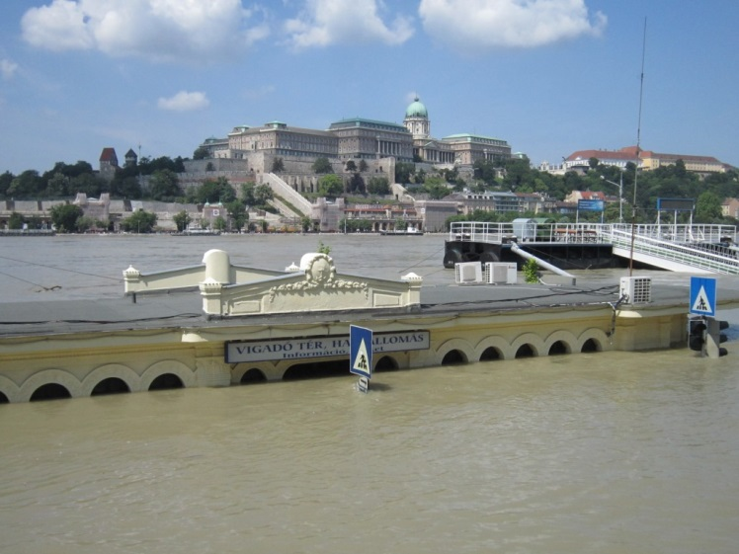
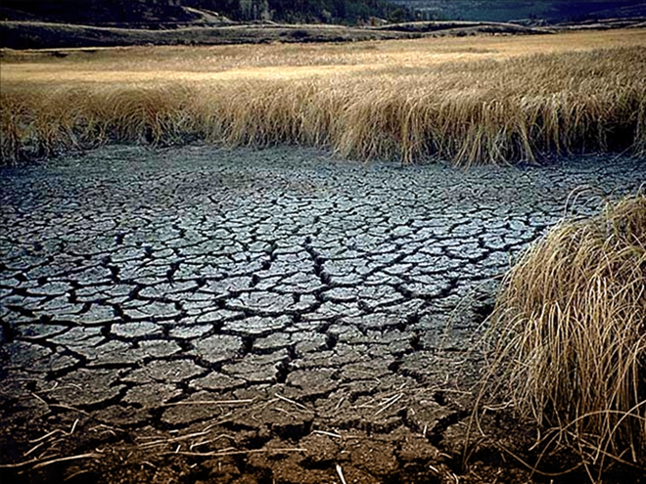
Water Resources Challenges 2/2
Water quality (organic, nutrient, hazardous pollution, HYMO alterations)
Floods and droughts
Governance (fragmented decision making, no clear mandates, overlapping responsibilities)

Slide 8
IWRM vs EU WFD
WFD as a core policy element for IWRM
Similarities: basin approach, PP, precautionary principle, transparency,
RBMPs provide mechanism to implement WFD and to achieve environmental objectives,
WFD not sufficiently balanced with socio-economic development goals.
there are other policies for integrated approach to environmental, economic and social development.
BUT
BUT
See Table 1, page 22

Slide 9
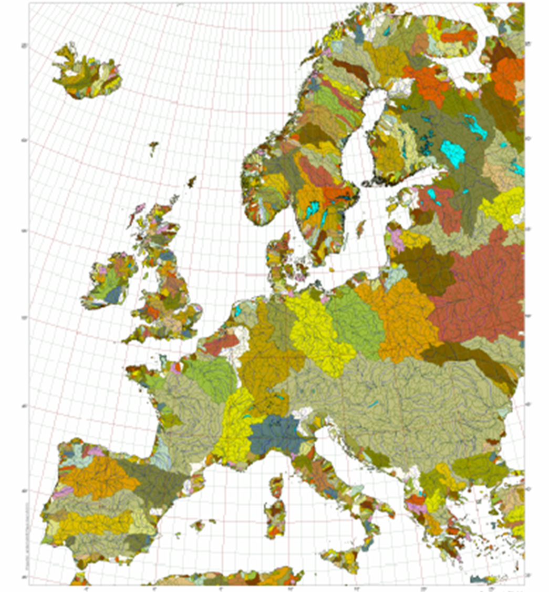
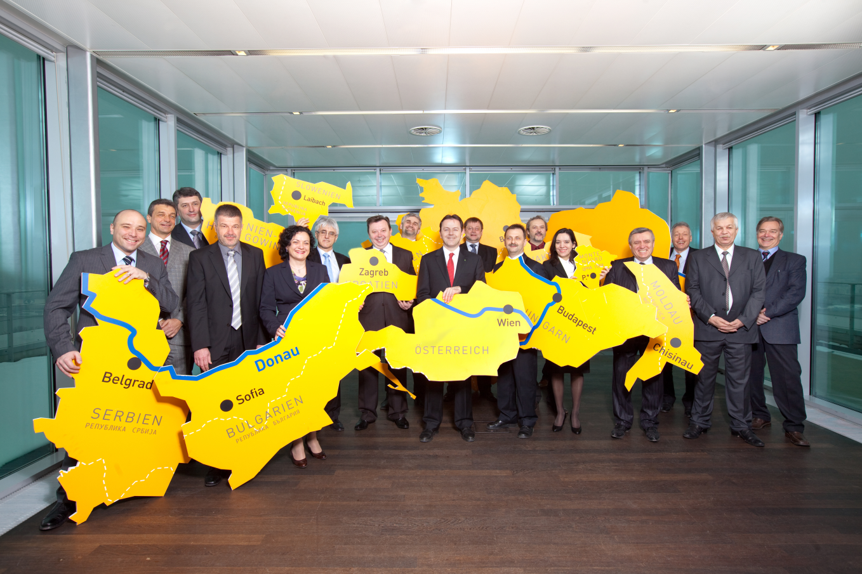
Achievements in IWRM in CEE region 1/3
the Danube
Water resources damaged/under threat, major polluter of Black sea
UN ECE Water Convention (1992) as a model
Danube River Protection Convention, 1994
ICPDR’s mission: promote, coordinate sustainable water management
GWP CEE observer, 2001
Non-EU MSs also implementing WFD
Danube RBMP (2009, 2015)

Slide 10
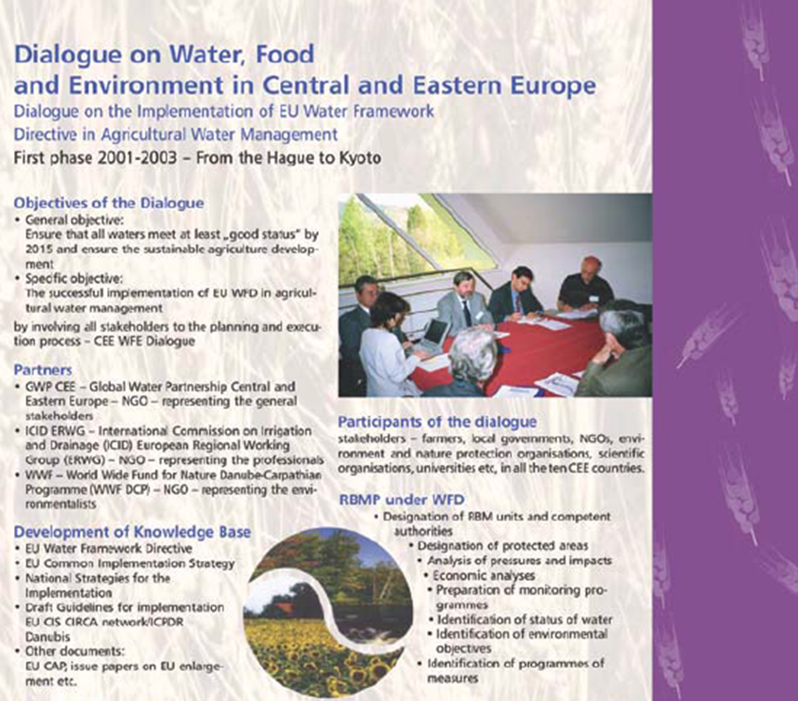
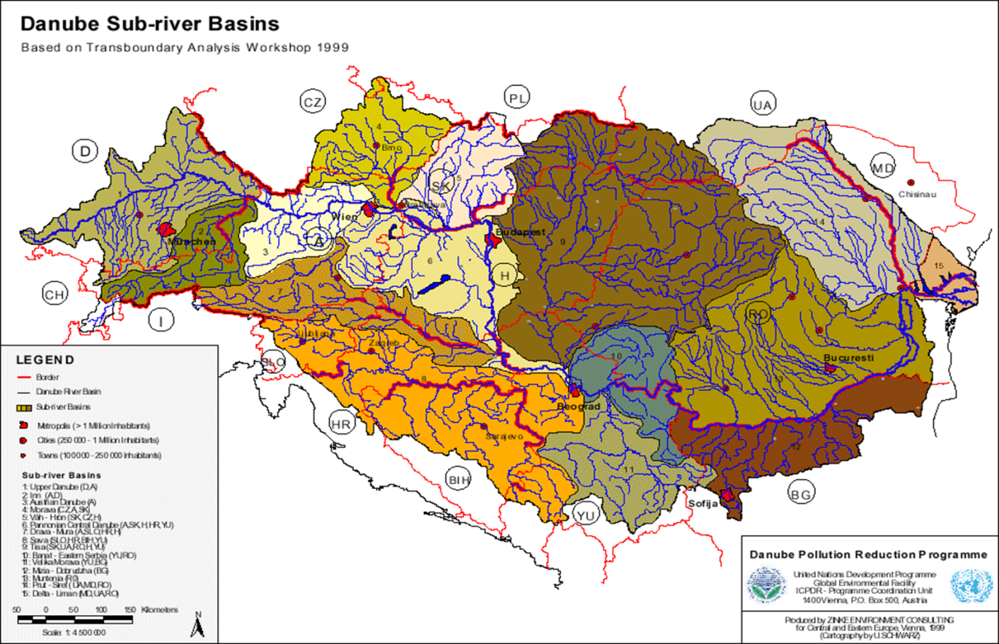
Achievements in IWRM in CEE region 2/3
Integrated Tisza RBMP (5 countries, 2010)
university curricula

Slide 11
Achievements in IWRM in CEE region 3/3
A joint Integrated Drought Management Programme to improve monitoring and prevention (2013-15):
Guideline for preparation of drought management plans,
National consultation dialogues,
Compendium of good practices,
Drought information exchange platform,
Demonstration projects,
Capacity building.

Slide 12
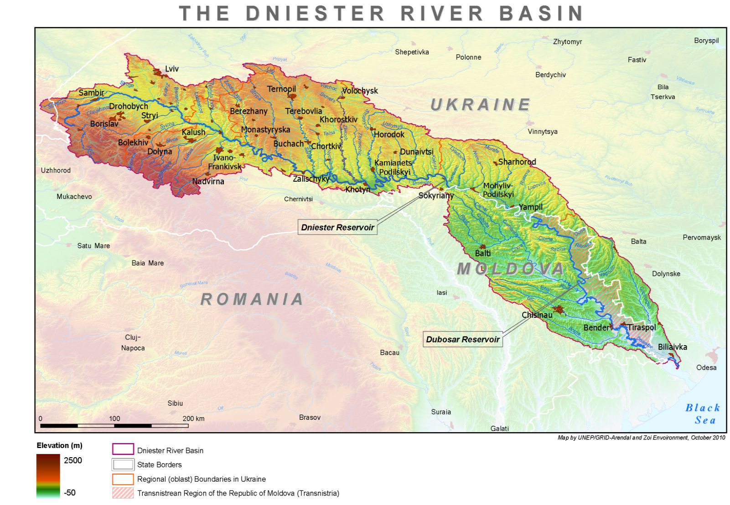
What failed: Dniester River Basin
Ukraine and Moldova
Ecosystems deteriorated (USSR)
Bilateral agreement since 1994
Implementation failed
Lack of institutional capacity
Mission of the two CWPs to urge authorities for better cooperation
Dniester Treaty 2013
Ukraine and Moldova are
Non-EU MSs

Slide 13
Conclusions in the paper
The main promoter of IWRM in CEE is GWP (RWP and CWPs), there is a niche for GWP in the region,
Achievements mainly on macro level (Danube as a model), stronger local level penetration is needed,
Better ‘vertical integration’ at different levels of administration,
Better ‘horizontal integration’ of water stakeholders,
Non EU MSs need help to catch up.

Slide 14
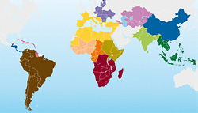
Key messages
Work consequently with stakeholders,
Make clear the difference b/w IWRM and WFD,
Happy to share the results with other regions

Slide 15
Read the full paper here:
http://www.gwp.org/en/ToolBox/PUBLICATIONS/Technical-Focus-Papers/
Learn more about the GWP CEE here:
http://www.gwp.org/en/GWP-CEE/
For more knowledge products of GWP Technical Committee here:
http://www.gwp.org/en/ToolBox/PUBLICATIONS/
Thank you for your attention

