Slide 1
Instructions – please delete
There are two alternative cover slides within this template (one featuring a photo, the other without a photo). Choose the one you wish to use. Then simply delete the other (by right-clicking on the slide within the view panel on the left-hand side and clicking ‘Delete Slide’).
If you want to change the picture, right-click on the picture and select ‘Change Picture’. Then click ‘Browse’ and navigate to where your desired photo is saved, select the photo and click ‘Open’. The new picture will appear in the same location as the previous picture, with curved edges (it may need to be resized). To curve the edges of a picture, select the picture and go to the ‘Format’ tab in the top menu bar. Then click ‘Crop’ and then ‘Crop to Shape’. Select the desired picture shape (‘rounded rectangle’ for curved edges, the shape name appears if you hold your cursor over the shape).
There are several alternative slide formats within this template – choose the slide layout(s) that best suits your content and add your content into these template slides. To insert a new slide, click on the small arrow next to ‘New Slide’ in the top menu bar – you will then see the selection of template content and title slides. Simply click on the desired slide layout to add a new slide of that design to your presentation. Delete the remaining slides that you do not wish to use by right-clicking on a slide within the view panel on the left-hand side and clicking ‘Delete Slide’.

Slide 2
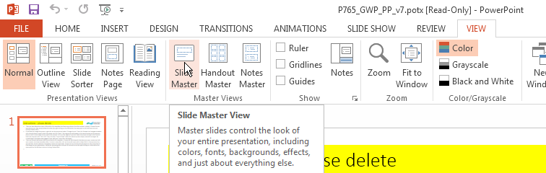
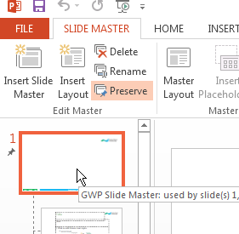

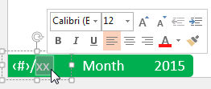
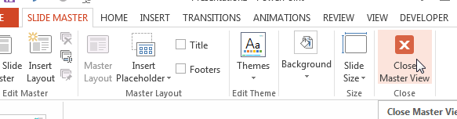
Instructions – please delete
Editing the footer
In the “View” tab, click “Slide Master” to enter the Master View.
Select the first slide on the left side of the Master View, called “GWP Slide Master”.
Click into the “Month”, “Year” and “Presentation Title” text boxes to set the footers for your whole presentation.
When you have finished adding slides to your presentation, change “xx” in the bottom left to the total number of slides.
Click “Close Master View” in the “Slide Master” tab to exit the Master View.

Slide 4


Slide 6



