Slide 1
PROGRESS of the aquatic ecosystems governance and challenges in south america
Néstor Mazzeo¹², Pedro Jacobi³, Cristina Zurbriggen⁴, María Mancilla⁵, Guillermo Goyenola¹, Paula Bianchi², Micaela Trimble² y Manfred Steffen²
1 CURE-Facultad de Ciencias, Universidad de la República, Maldonado-Uruguay
2 Instituto SARAS2, Maldonado-Uruguay
3 Universidad de Sao Paulo; Brasil
4 Facultad de Ciencias Sociales, Universidad de la República, Uruguay
5 Stockholm Resilience Center, Sweden
Email: mazzeobeyhaut@yahoo.com

Slide 2
Development of the main paradigms of water resources management
Focus
Lessons from two water crisis: Sao Paulo and metropolitan area of Uruguay
Challenges
Do scientists have adequate training and an attractive incentive scheme of academic evaluation to make relevant transformations of water resources management?
IAI Proposal

Slide 3
Development of the main paradigms
1977
>1985
Command- control
Integrated management
Adaptive management
Overcome the fragmentation in the analysis and decision-making processes
Incorporate and properly handle uncertainty and promote the social learning

Slide 4
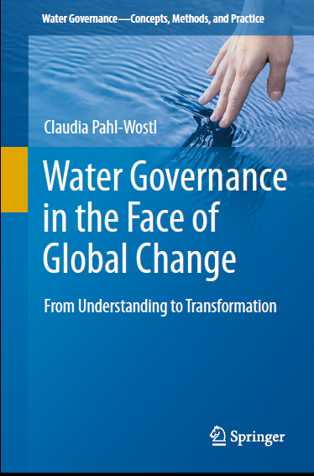

Slide 5
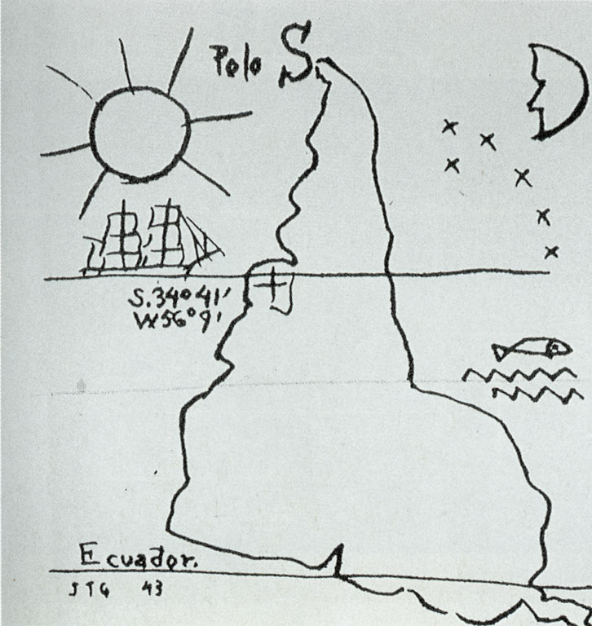
Latin America transition
Command- control
Integrated management

Slide 6
Focus
The purpose of this talk is to analyze the strengths and weaknesses of the governance systems observed in Brazil and Uruguay, considering the main lessons learned from two crisis: Sao Paulo water crisis and the drinking water supply in the metropolitan region of Uruguay.

Slide 7
Focus
From the lessons learned I want to explore: what are the current contribution and roles of the Limnologists in the governance system and if they have real capacities to promote substantial transformations.

Slide 8
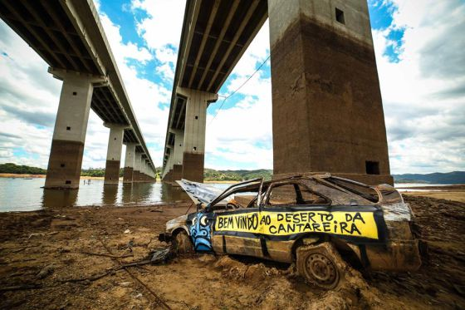
Water crisis in sao Paulo
Is the São Paulo crisis a study case promoted exclusively by the climate variability, is it a management crisis or an interaction between both factors?

Slide 9
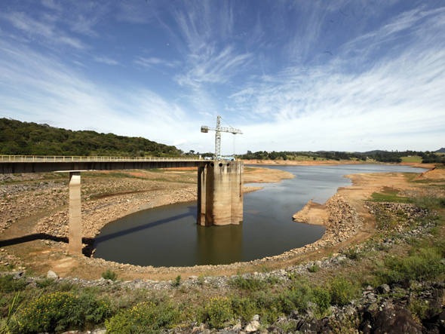
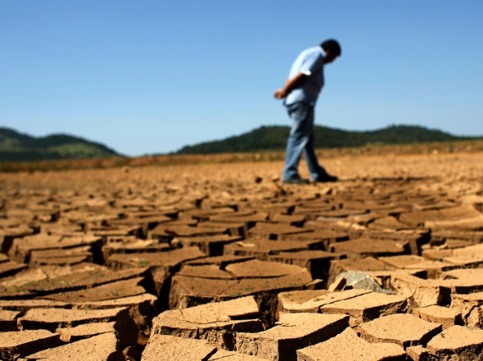
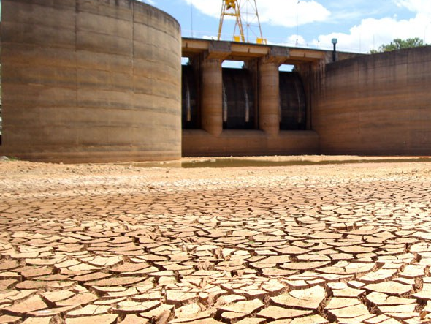
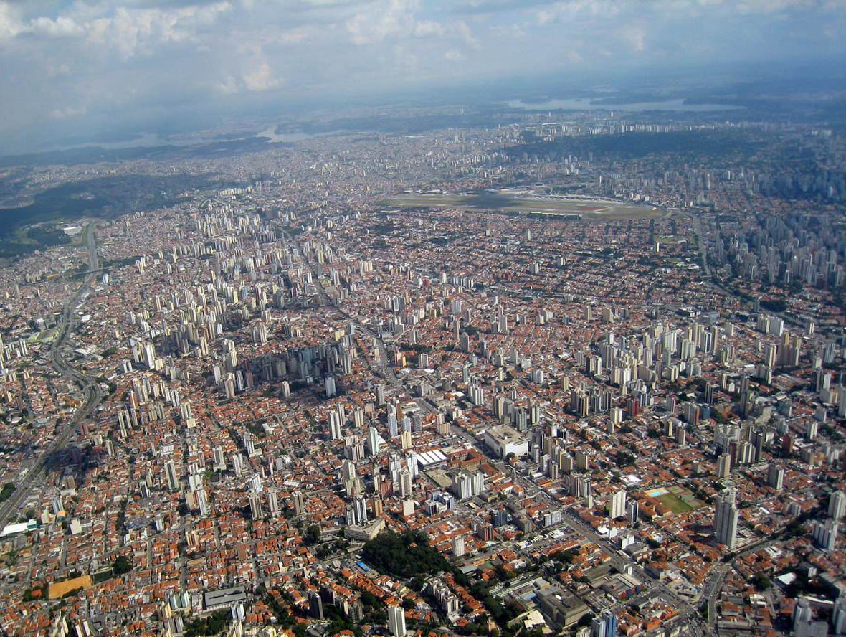
Water crisis in sao Paulo
+ The water crisis in São Paulo clearly follows a scenario of reduced rainfall in the southeastern region of Brazil in the period 2011-2015.
+ However, other drivers or pressures interacted simultaneously.

Slide 10
Water crisis in sao Paulo
+ The increase of urban areas in the metropolitan region and its impacts on recharge of surface and groundwater systems.
+ Unplanned occupation of key reservoir margins.
+ Deterioration of the water quality of several crucial reservoirs of the water supply system.
+ Structural problems of the management system (Jacobi et al. 2012; Souza, 2015).

Slide 11
Water crisis in sao Paulo
+ Brazil is a regional example of the transitions between command-control and integrated management observed in various regions of the planet.
+ In the case of San Pablo, the transition tried to overcome the fragmented, centralized management, organized according to political-administrative scales and in the hands of a state technocracy, controlled almost exclusively by the interests of the electricity sector (Souza Jr. and Fidelman 2009).

Slide 12
Water crisis in sao Paulo
+ Unfortunately, the new institutional arrangement of the 1990s failed to establish negotiation and collaboration spaces, with little participation in the new bridges institutions (basin committees) (Jacobi et al., 2015).
+ At the moment, it is not possible to consolidate a system of integrated management of water resources according with their full potential and transition to adaptive management appear very distant in time.

Slide 13
Water crisis in sao Paulo
+ Crucial message: changes in the structure of the systems do not guarantee, by themselves, the fulfillment of the objectives or goals.
+ The characteristics and skills of the actors are as relevant or more than the structure of the management system.

Slide 14
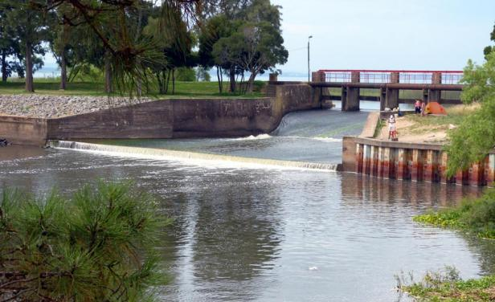
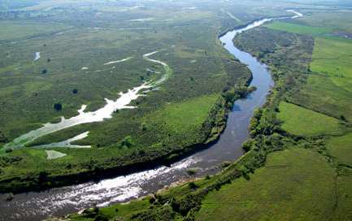
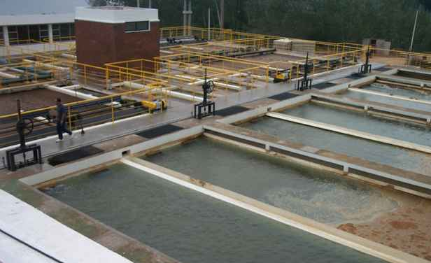
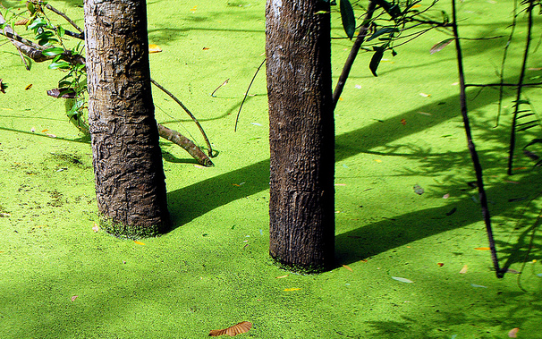
drinking water supply in the metropolitan region of Uruguay
+ The main reservoirs show eutrophic conditions and recurrent blooms of cyanobacteria with cyanotoxins productions (Mazzeo et al. 2015).
+ The water quality crisis is due to the interaction of important transformations of land use, climatic variability and the inefficiency of management systems.

Slide 15
drinking water supply in the metropolitan region of Uruguay
+ The transition between command-control and integrated management occurred through a constitutional reform approved by a referendum in 2004, the last referendum approved by popular vote.

Slide 16
drinking water supply in the metropolitan region of Uruguay
+ The creation of the watershed commissions and other bridge structures foreseen in the referendum and the Water Policy of 2009, began to be implemented in 2010.

Slide 17
drinking water supply in the metropolitan region of Uruguay
+ The performance of the basin commissions in Uruguay represents an important advance, creating formal spaces for the coordination and complementation of a constellation of institutions located at different levels (national, departmental, and municipal), and also promotes the interaction with users and the different interests of society.

Slide 18
drinking water supply in the metropolitan region of Uruguay
+ The agreements reached in the bridge institutions are not binding and the control of implementation is social.

Slide 19
drinking water supply in the metropolitan region of Uruguay
+ The main difficulty is the significant inertia found in the institutional structure directly responsible for the implementation, control and monitoring of the agreed measures and strategies defined in the basin commissions and other bridge structures recently created.

Slide 20
Challenges for ACADEMIC SECTOR
+ A substantial part of the inertia and difficulties in the transition between command-control and integrated management is supported by the university education of the actors (the majority) involved in the management system.
+ University education is built on reductionism and a very weak formation in systems theory, complex and dynamic systems and resilient thinking.

Slide 21
We live on an island of knowledge surrounded by a sea of ignorance. As our island of knowledge grows, so does the shore of our ignorance. John A. Wheeler, Scientific American (1992).

Slide 22
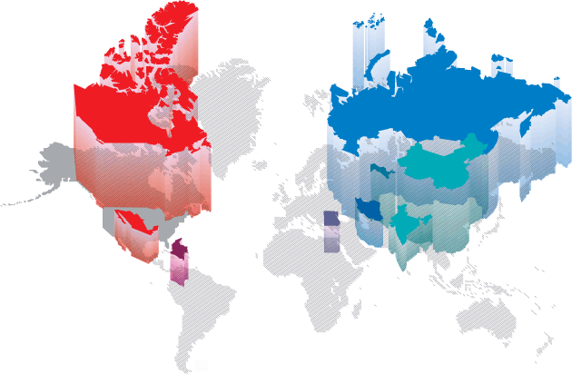
……the world has problems, universities have departments (Brewer 1999) and the States have Ministers (Terra, 2015).

Slide 23
Do scientists have adequate training and an attractive incentive scheme of academic evaluation to make relevant transformations of water management?

Slide 24
Transforming water governance in South America: from reaction to adaptation and anticipation
IAI TRANSDISCIPLINARY PROJECT

Slide 25
To analyze the water supply/scarcity crisis in South America (scientific literature, news media, social networks) and the responses of the governance and learning processes associated.
Evaluate the capacities of adaptation, resilience (adaptation + transformation) and anticipation in a set of study systems on which the team is already working, in Argentina, Brazil and Uruguay.
Identify and explain how dialogue, or not, multiple disciplinary knowledge and domains (knowledge types, thinking logics, worldviews) to co-create new knowledge, to make decisions, how the future is used.

Slide 26
4. Contribute to the governance of water in the region, with emphasis on decision-making process, participation and legitimacy, based on the strengthening of anticipatory capacities, the articulation of knowledge, the promotion of experimentation and associated social learning mechanisms.

