Slide 1
Global and Asian Challenges on Water-related Disasters
And Position of
“Principles on Investment and Financing for Water-related Disaster Risk Reduction”
Kenzo Hiroki
Professor, National Graduate Institute for Policy Studies (GRIPS)
Coordinator, High-level Experts and Leaders Panel on Water and Disasters (HELP)

Slide 2
Why Water and Disasters?

Slide 3
Glimpse of a water-related disaster, March 11th, 2011
Viewed from Kamaishi City Hall

Slide 4
Why Water and Disasters?
We should not repeat the Tragedy
for our family, people, and nation

Slide 5
Disasters are increasing in numbers and impacts

Slide 6
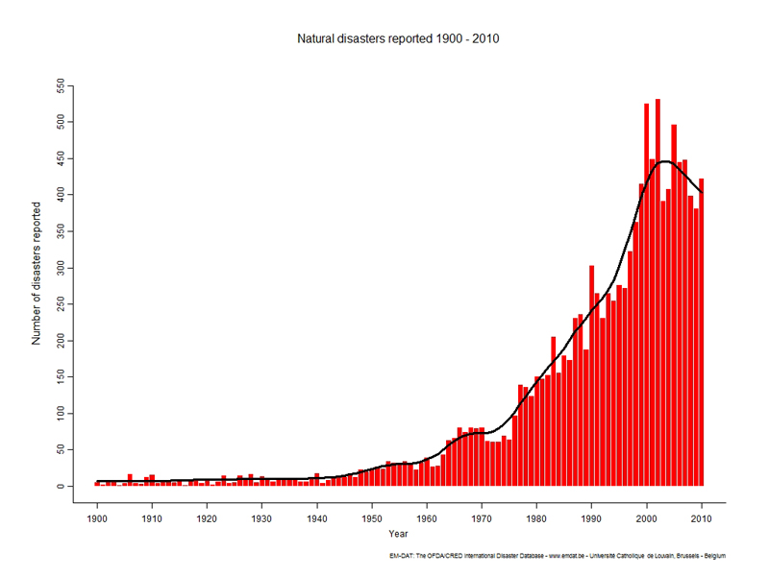
Number of reported natural disasters(1900-2010)
500
400
300
200
100
Year
Source: ISDR “EM-DAT”

Slide 7
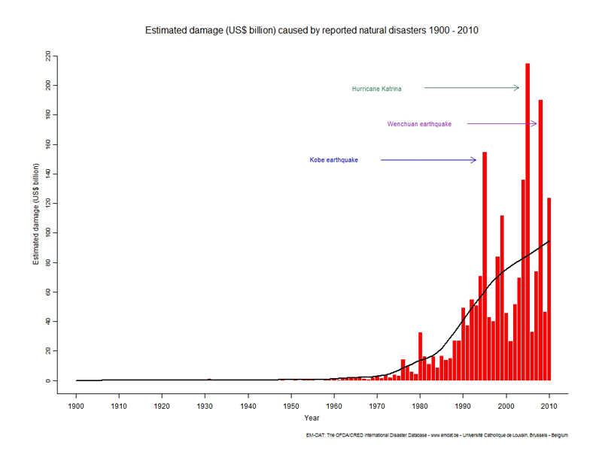
Estimated damage caused by natural disasters
(1900-2010)
Billion USD
200
100
Year
Source: ISDR “EM-DAT”

Slide 8
Number of people affected by disasters
(1994-2013)
Total:
5.7 billion

Slide 9
Number of people affected by disasters
(1994-2013)

Slide 10
Number of people affected by disasters
(1994-2013)
Anybody on earth will be hit by disasters twice in his/her life time on average, mostly by water-related disasters, sometimes fatal.
Total:
5.7 billion/20 years

Slide 11
The world has lost 2.7 trillion USD in 20 years (1995-2015) by disasters. 70 % of the loss by water-related disasters

Slide 12
“Water and Disasters” is strongly linked to poverty issue

Slide 13
Number of fatalities by floods (2001-2010)
- 70 % of human loss by flooding are from “low income” or “lower middle income” countries -
Low Income: 23%
Lower Middle Income: 45%
High-income economies ($12,276 or more)
Upper-middle-income economies ($3,976 to $12,275)
Lower-middle-income economies ($1,006 to $3,975)
Low-income economies ($1,005 or less)
Water and disasters are strongly linked to poverty issues

Slide 14
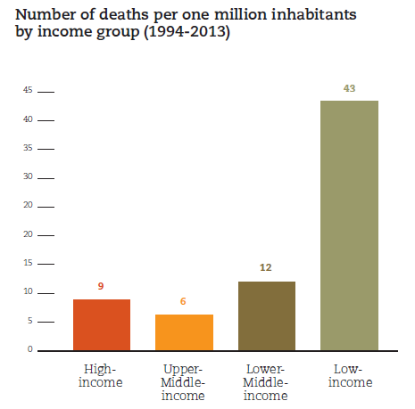
Number of disaster deaths per one million inhabitants by income groups (1994-2013)
40
30
20
10
0
High-income
Upper
Middle-income
Lower
Middle-income
Low-income

Slide 15
Principles on Investment and Financing for Water-related Disaster Risk Reduction

Slide 16
Response of Global Community
to Ever-increasing Disasters and Their Impacts

Slide 17
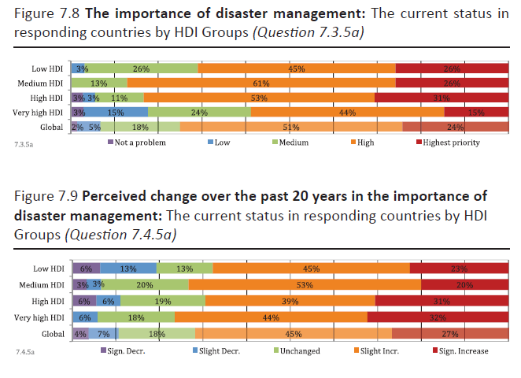
Disaster management is gaining importance within governments
Perceived change in the importance of disaster management over the past 20 years
Significant
decrease
Slight
decrease
No
change
Slight
increase
Significant
increase
70% of countries think disasters have become more important among the government priorities
Status Report on Integrated Water Resources Management and Water Efficiency Plans. UN-Water. 2008

Slide 18
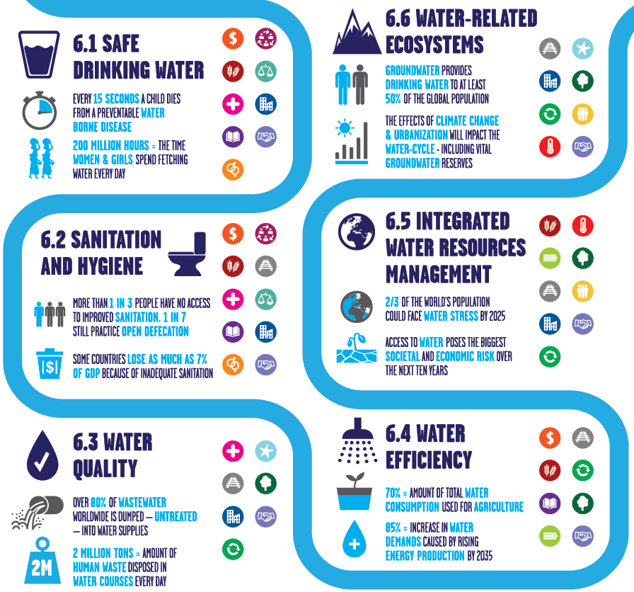
Six Targets of SDG6
Comprehensive goals and targets on water
The targets are related to other development agenda such as health, food, education, and gender
Each of Targets has indicator(s) and monitoring agencies

Slide 19
Four Priorities for Action of Sendai Framework
Understanding disaster risk.
Strengthening disaster risk governance to manage disaster risk.
Investing in disaster risk reduction for resilience.
Enhancing disaster preparedness for effective response and to “Build Back Better” in recovery, rehabilitation and reconstruction.

Slide 20
Principles on Investment and Financing for Water-related Disaster Risk Reduction
Background
“Investing in disaster risk reduction for resilience” as one of the four priority actions in the Sendai Framework
“By 2030, significantly reduce …substantially decrease the direct economic losses caused by disasters, including water-related disasters…” as SDG Target 11.5
“We commit to promote disaster risk reduction and management, through supporting the development of disaster risk reduction strategies and periodical assessments of disaster including standards for risk levels (HABITAT III)

Slide 21
High Level Panel on Water (HLPW)
convened by UN Secretary-General and President of the World Bank Group

Slide 22
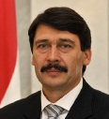
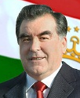
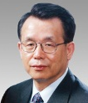
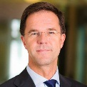
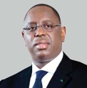
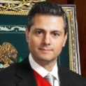
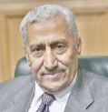
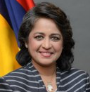
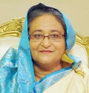
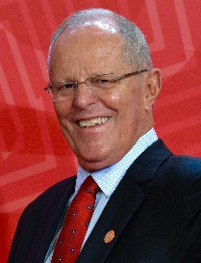
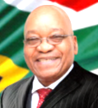
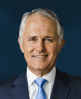

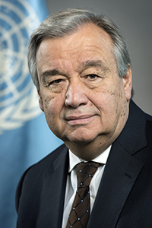
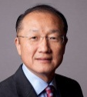

High Level Panel on Water (HLPW)
Special Advisor
János Áder
Emomalii
Rahmonov
Dr. Han
Seung-soo
Kevin Rutte
President
Hungary
President
Tajikistan
Prime Minister
Netherlands
`
`
Former Prime Minister, Republic of Korea
`
Macky Sall
President,
Senegal
Enrique Peña
Nieto
Abdullah
Ensour
`
President,
Mexico
Prime Minister
Jordan
`
`
Sheikh
Hasina
Ameenah
Gurib-Fakim
`
President,
Mauritius
Prime Minister
Bangladesh
`
Pedro
Kuzynski
President
Peru
Jacob
Zuma
Co-chairs
Malcolm
Turnbull, PM
`
President
South Africa
Co-convened by:
Australia
Antonio Guterres
Jim Yong Kim
President
World Bank Group
UNITED NATIONS
UN Secretary-General

Slide 23
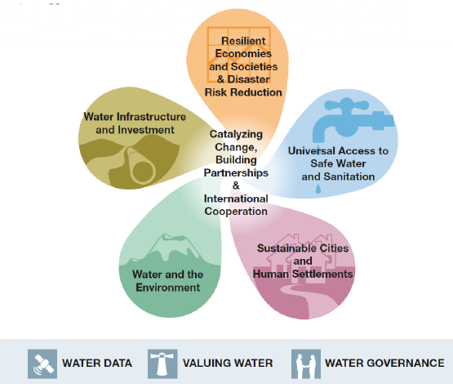
HLPW Action Plan “9 Areas of Action”
1. Catalyzing Changes, Building Partnerships
and International Cooperation
2. Resilient Economies, Societies,
and Disaster Risk Reduction
3. Universal Access to Safe Water
and Sanitation
4. Sustainable Cities and Human
Settlements
5. Water and the Environment
6. Infrastructure and Investments
7. Water Governance
8. Water Data
9. Valuing Water

Slide 24
Recommendations on Disaster Risk Reduction in HLPW Outcome Document
HEADLINE RECOMMENDATION
Shift focus of disaster management from response to preparedness and resilience
DETAILED RECOMMENDATIONS
Financing for and investment in water-related DRR and resilience should be doubled within the next five years.
“Principles on Investment and Financing” should be used to make effective use of this increased investment and could help increasing investments in countries.

Slide 25
Challenges “the Principle” need to address
Sometimes the biggest hurdle is convincing the government to decide and commit to financing infrastructure (USACE)
Risk prevention should be integrated with long-term planning and create opportunities for synergies with planned investments (Netherlands)
Investment for “disaster prevention” needs to be strengthened for protection of economic development gains and consistent progress of the economic growth. (Japan)
There is a need for long term financing strategies to improve resilience …particularly at the national government level. (OECD)
It is also important to look into innovative financing. Insurance industry is least developed in developing countries. (UNESCAP)
Organizations such as donors will need to increase the amount of investment. (KOICA)
Disaster risk reduction is not merely a cost, but an investment for stronger development which pays off in the future. (JICA)

Slide 26
Objectives of the Principle
Build convincing arguments and logics (e.g. addressed to Finance Ministry) that disaster risk reduction pays off
Establish standardized methodology to analyze cost of water-related disasters, particularly indirect cost
Create portfolio of innovative/alternative financing for water-related disaster risk reduction
Promote identifying and sharing good practices on financing and investing in water-related DRR
Recommend legal/administrative/budgetary system that ensures long-term financial flow for DRR investment
Recommend strategies to make the above to happen in countries

Slide 27
Chronology towards Finalization of the Principles
2015-
2018
Mar. 15
May 3
Aug. 26
Oct. 9
Oct. 12
Nov. 1
2019
Feb. 28
Mar. 22
Apr. 18
Apr. 23
June 24
July-
Global Community prioritizes financing DRR (SDGs, Sendai, Habitat III)
HLPW recommended creation of the Principles
Announcing Draft Principle in the 12th HELP Meeting, Geneva
Global Consultation Meeting I on the Principles in Stockholm WWW
1st Regional Consultation Workshop on the Principles in Central and Eastern Europe in Bucharest, Romania
2nd Regional Consultation Workshop on the Principles in South West Asia, in Colombo, Sri Lanka
3rd Regional Consultation Workshop on the Principles in Africa in Livingstone, Zambia
Global Consultation Meeting II in OECD, Paris
4th Regional Workshop on the Principles in Hanoi, Vietnam
Global Consultation Meeting III in the Hague, the Netherlands
5th Regional Consultation Workshop in Montevideo, Uruguay
Launching the Principles in the 4th UN Special Thematic Session on Water and Disasters in UN-HQs, New York
Operationalizing the Principles in the World

Slide 28
Thank you

