Slide 1

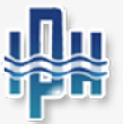



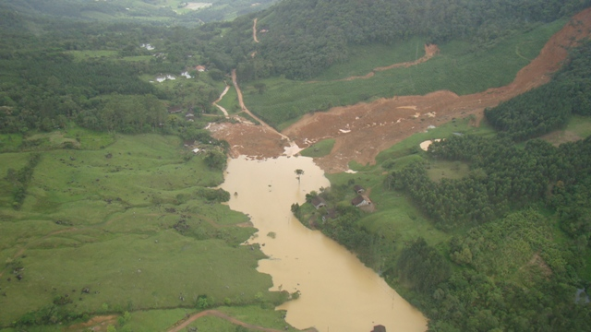
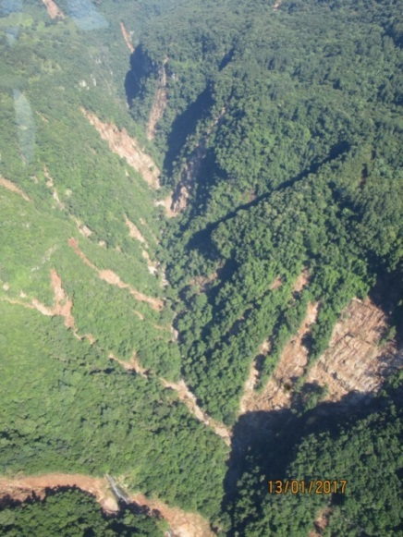
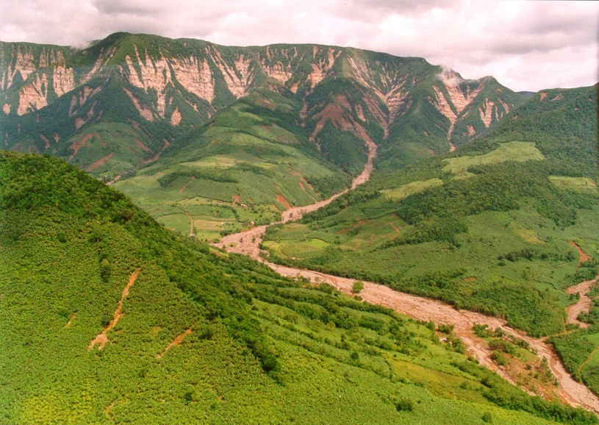
Montevideo, Uruguay, 23 April 2019
HELP-GWP consultation meeting on
Draft Principles on Investment and Financing for Water-related Disaster Risk Reduction
Some problems of water-related disaster risk reduction in (southern) Brazil
Prof. Masato Kobiyama
Natural Disasters Research Group (GPDEN)
Hydraulic Research Institute (IPH)
Federal University of Rio Grande do Sul (UFRGS), Brazil

Slide 2
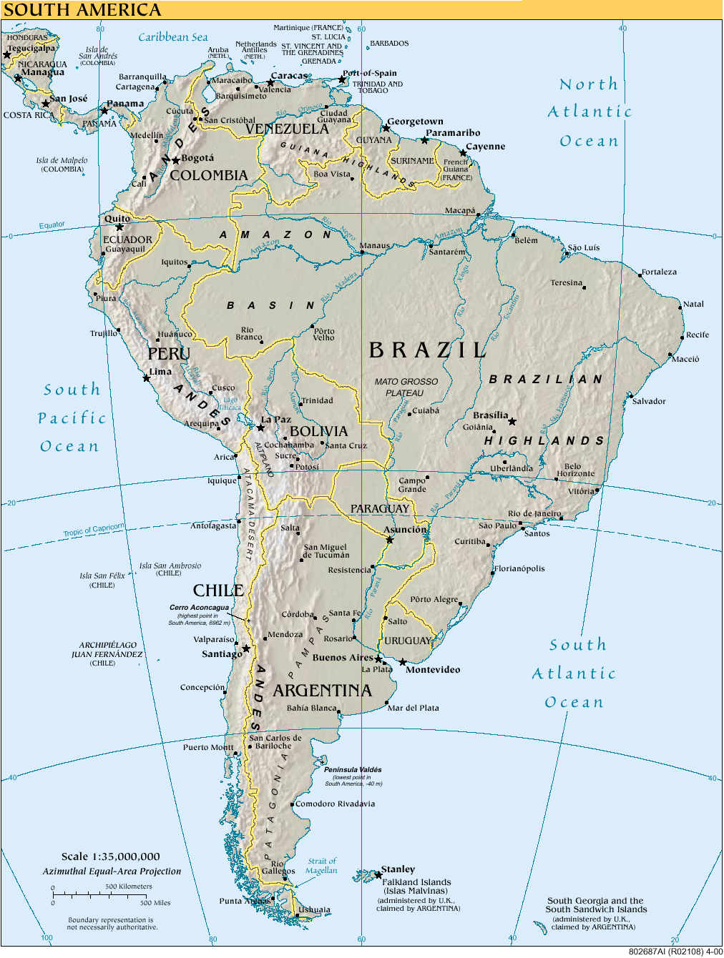
Presentation
Geography in (southern) Brazil
Encountered problems in water-related risk reduction
Suggestions for investment to reduce water-related disaster
Final considerations
Southern Brazil

Slide 3
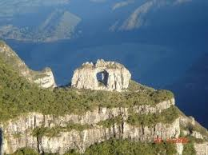
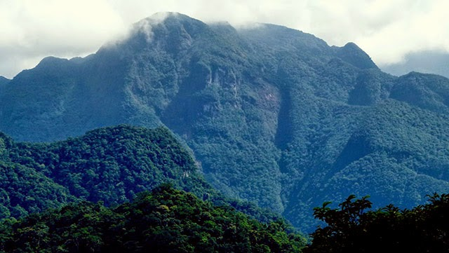
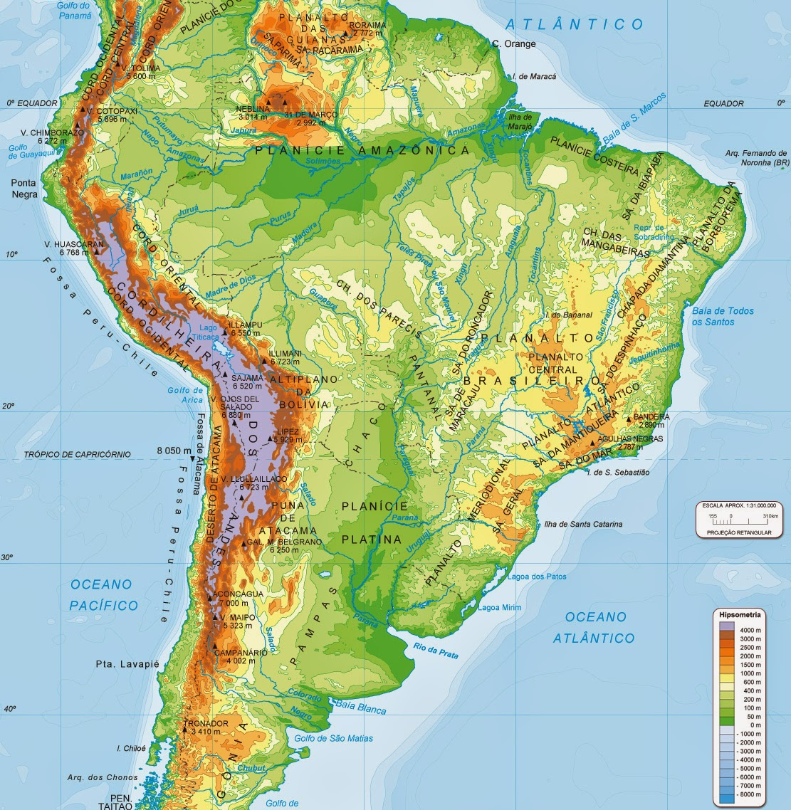
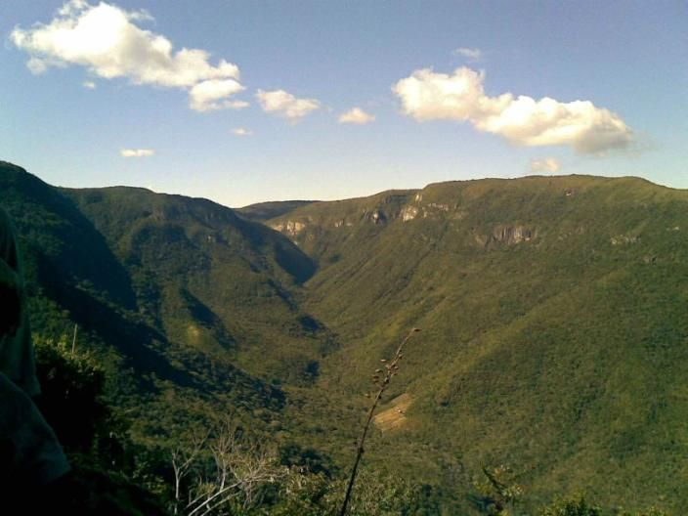
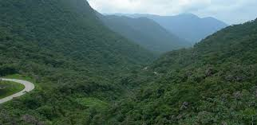
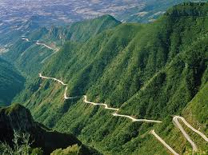
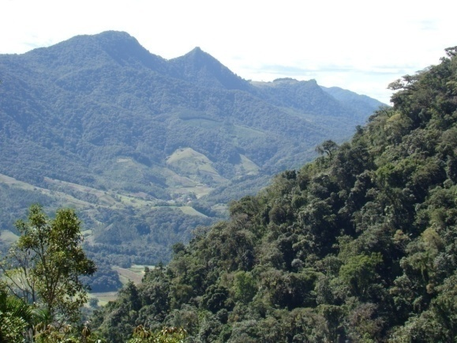
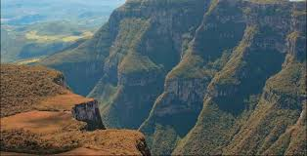
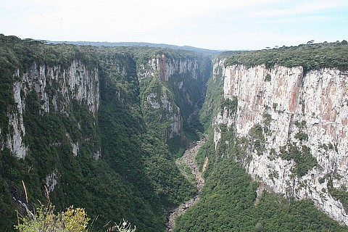
1. Geography in (southern)
Brazil
What characterizes the eastern part of Brazil?
Mountains and hillslopes (and high population)
3

Slide 4
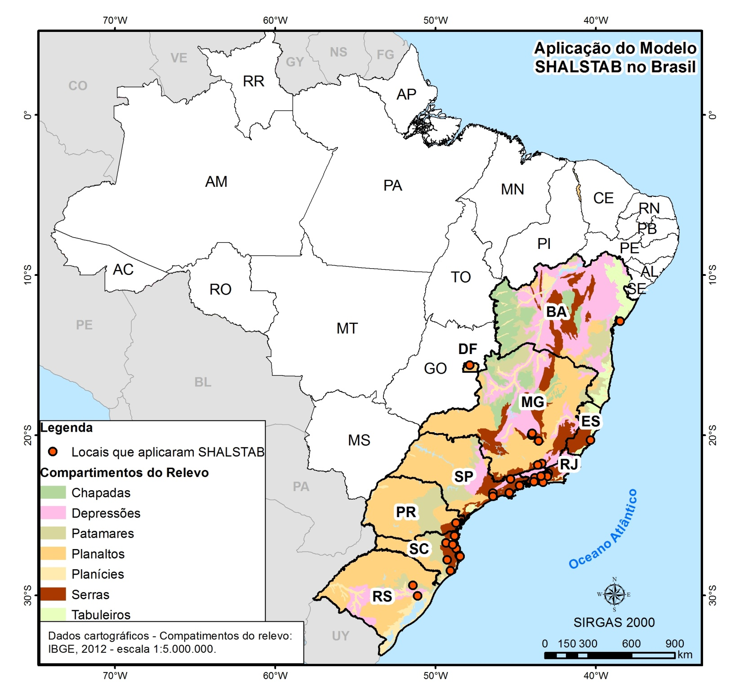
Locations of SHALSTAB application in Brazil
(Melo & Kobiyama, 2018)

Slide 5
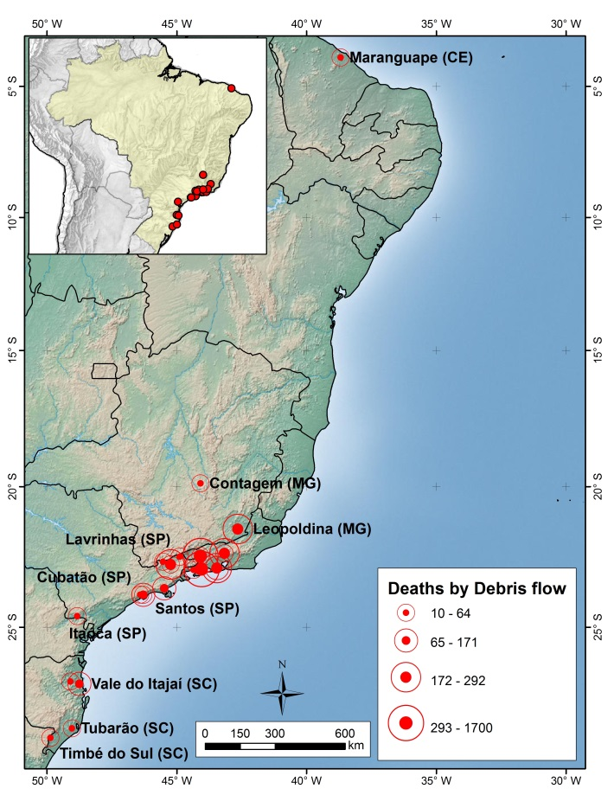
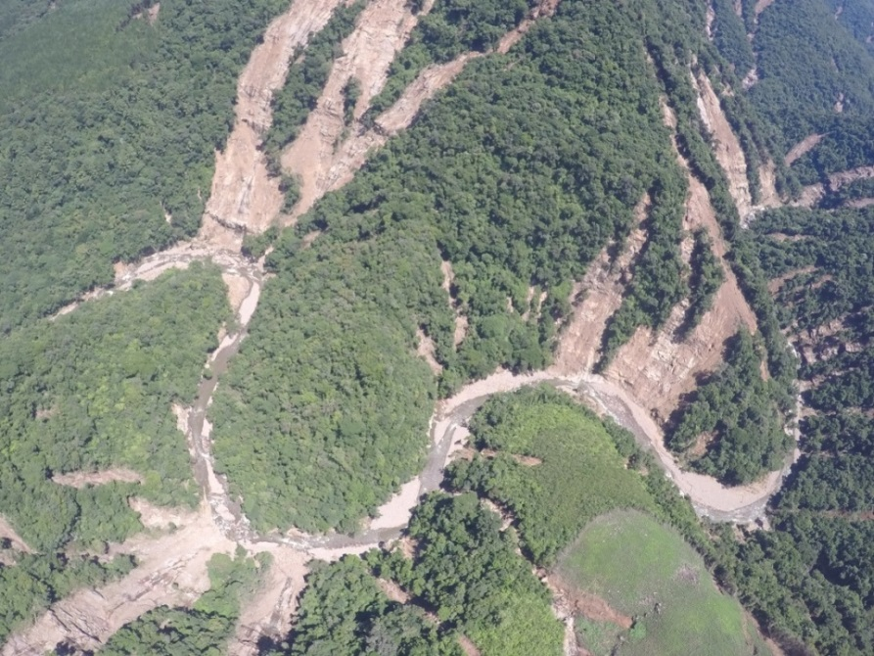
Locations of large disasters with debris flows in Brazil during the period 1900-2014 (Kobiyama et al., 2019)

Slide 6
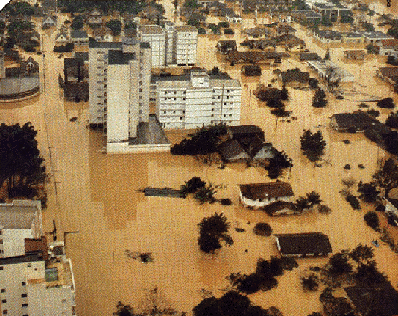
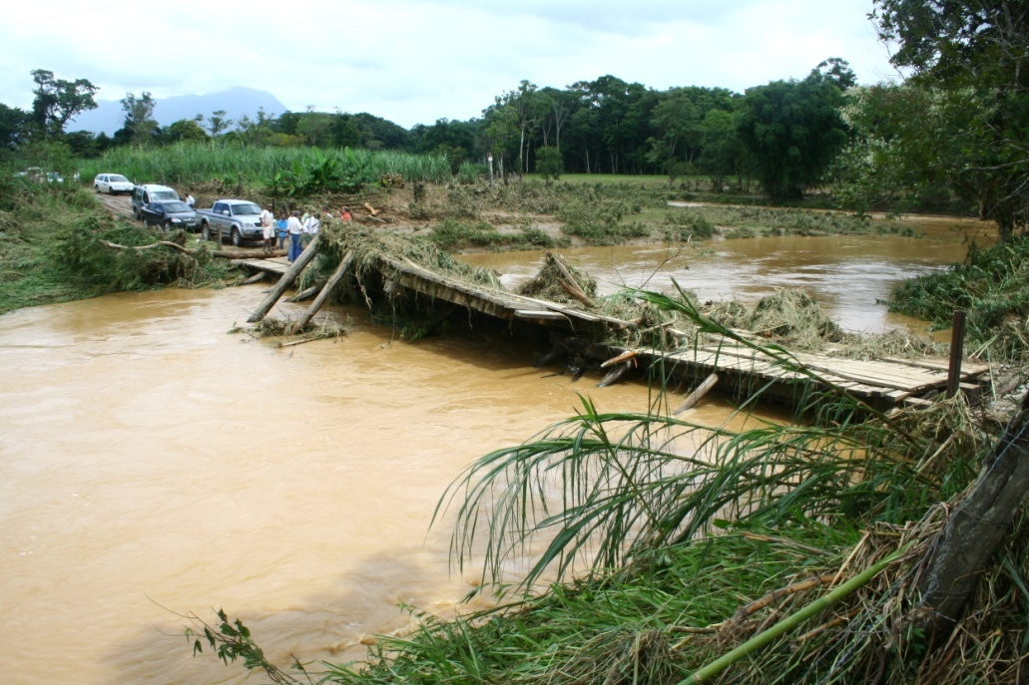
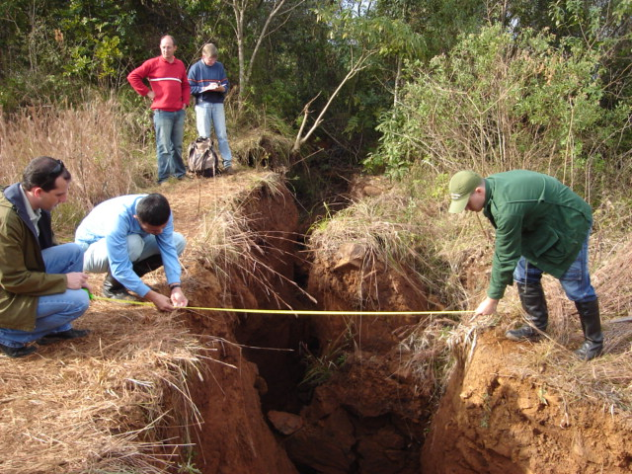
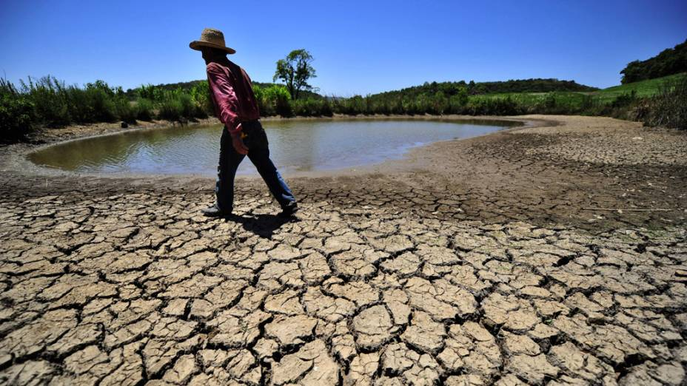
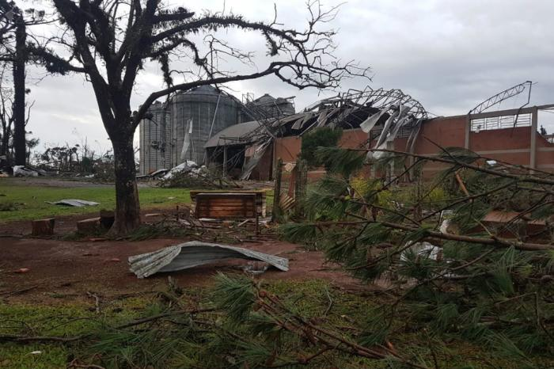
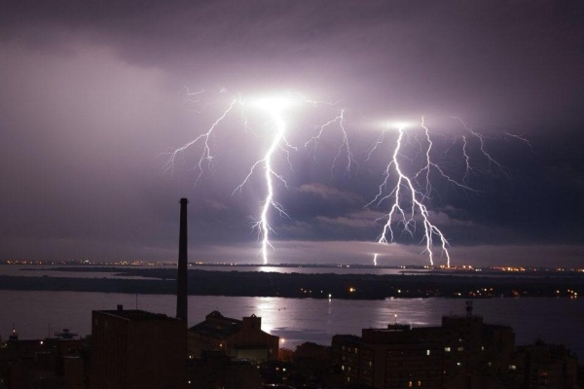
Flood
Flash flood
Landslide
Typical water-related disasters in southern Brazil
Debris flow
Dam break
Drought
Storm
Thunderstorm

Slide 7
2. Encountered problems in water-related risk reduction
Lack of a digital elevation model (DEM) construction for the entire country (a 1: 10,000 base)
Lack of rainfall gauge and discharge monitoring stations in Brazil. Especially for small catchments (< 50 km²) where flash floods are predominant.
Very slow action in early-warning system because of the federal government system (CEMADEN - Centro Nacional de Monitoramento e Alertas de Desastres Naturais). Need to have state or regional level centers for monitoring and alert system.
Lack of training courses on hydrology (hydrogeomorphology, hydrometeorology, hydropedology, etc.) by universities and local communities for all the citizens. – Citizen science.
Lack of database (maps, historical records, monitoring data, etc.)

Slide 8
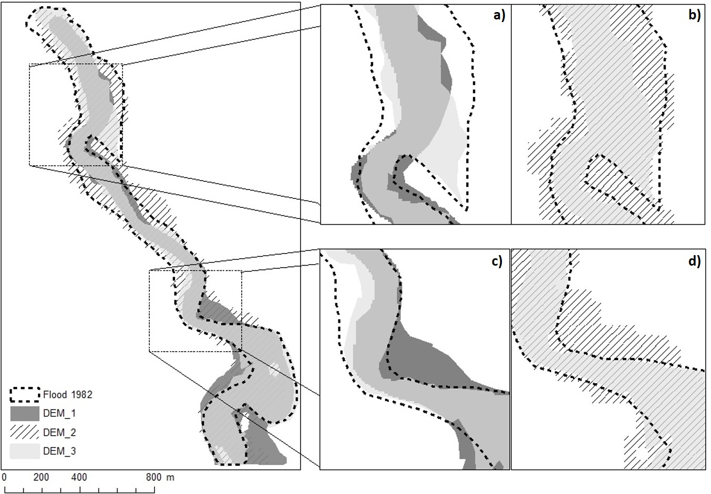
2.1. Digital Elevation Model - DEM
Observed and simulated flood areas by CAESAR-Lisflood in São Vendelino municipality in Brazil. Note that (a) and (c) compare the observed area to the simulated areas with DEM_1 and DEM_2; and (b) and (d) compare the observed area to the simulated areas with DEM_2 e DEM_3. (Zambrano et al., submitted)

Slide 9
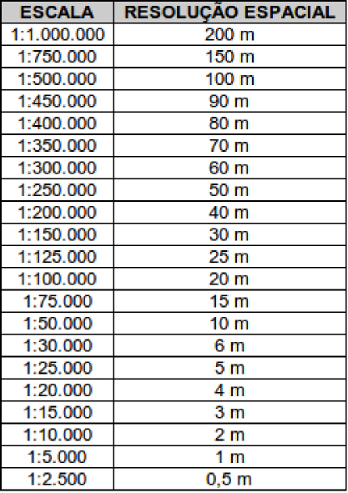
Common scale in Brazil →
Desired scale in Brazil →
Common scale in Japan →

Slide 10
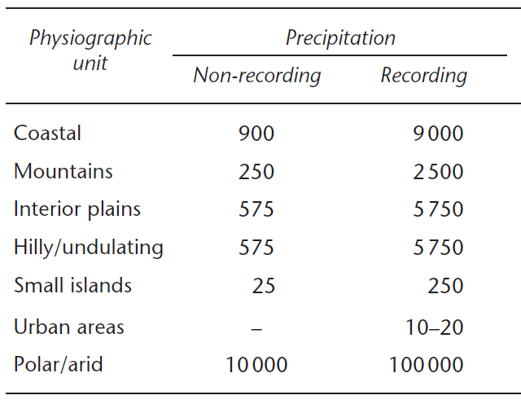
2.2. Monitoring system
Monitoring |  |  | Drainage area (km²)
Purpose | 0 -500 | 501-5000 |  | 5001-50000 | 50,001-500,000 |  | >500,000
Rainfall | 1 | 3 |  | 4 | 6 |  | 7
Lake | 1 | 1 |  | 1 | 1 |  | 1
River | 1 | 3 |  | 4 | 6 |  | 7
Sediment | 1 | 2 |  | 2 | 3 |  | 3
ANA-ANEEL Joint Resolution No. 3 (2010)
Recommended minimum densities of stations (area in km² per station) by WMO (2008)

Slide 11
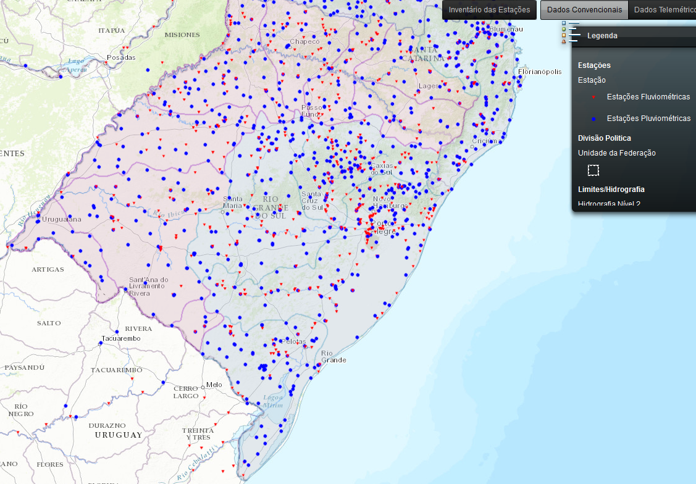
According to Hidroweb/ANA, the Rio Grande do Sul state (281.748 km²) has 501 river gauges and 535 rainfall station.
562 km² per 1 river gauge
526 km² per 1 rainfall station

Slide 12

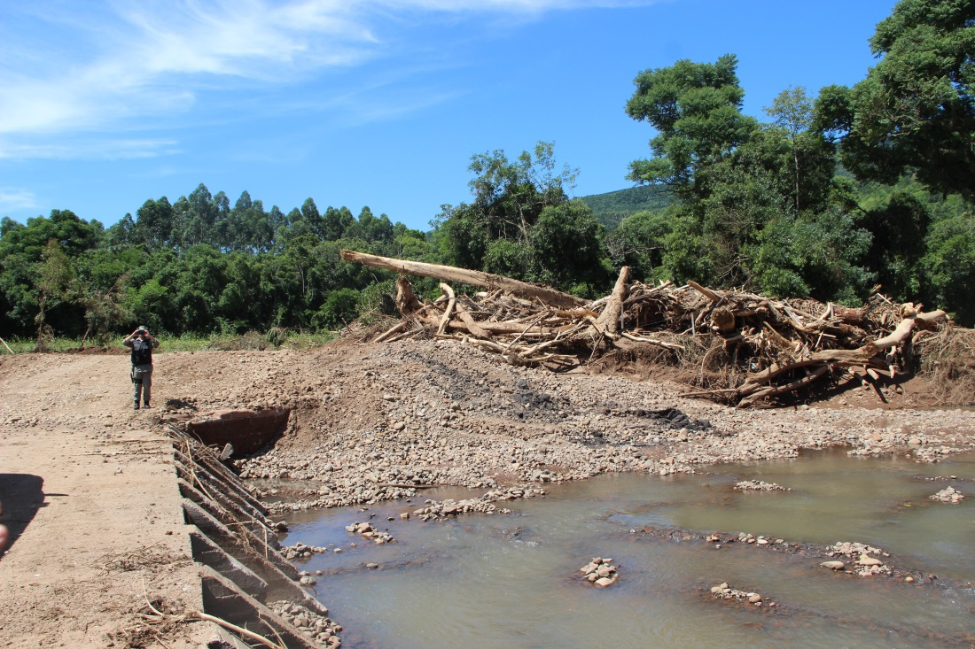
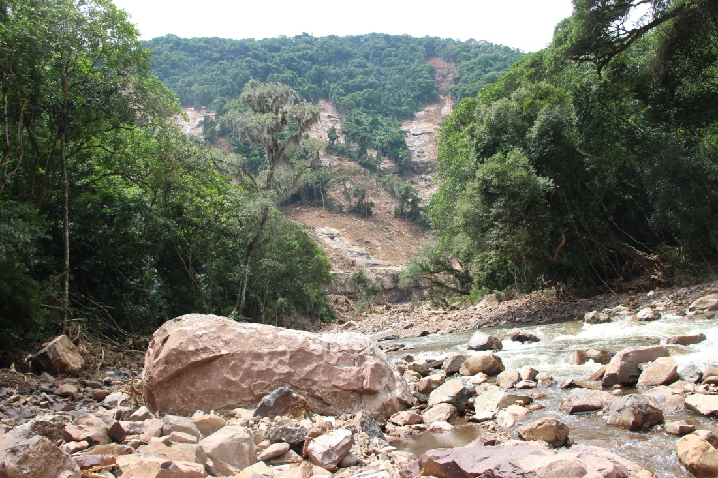
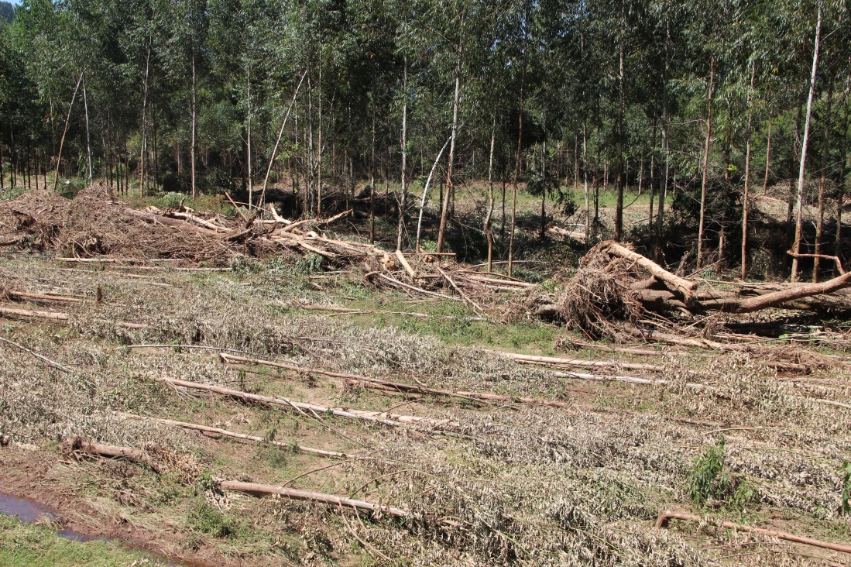
Rolante/RS in January 2017

Slide 13
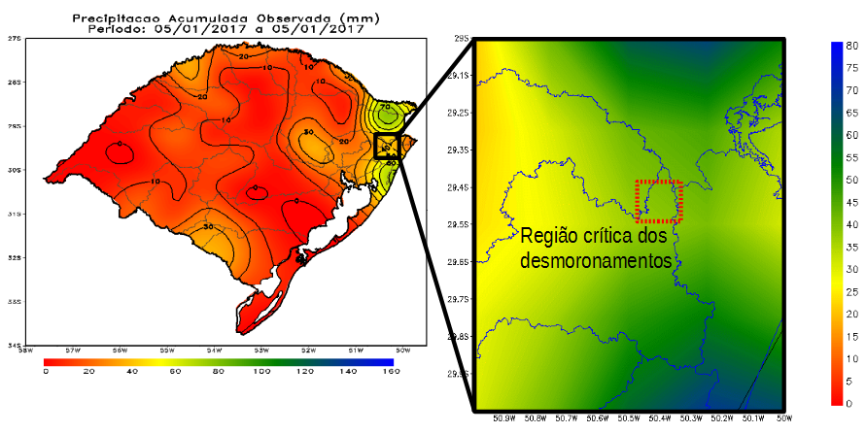
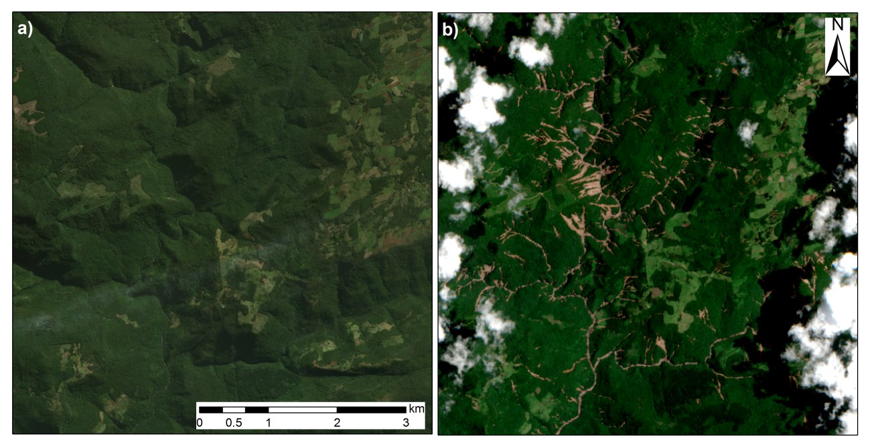
Accumulated precipitation estimated only with data obtained at the official monitoring stations (SEMA-GPDEN, 2017).

Slide 14
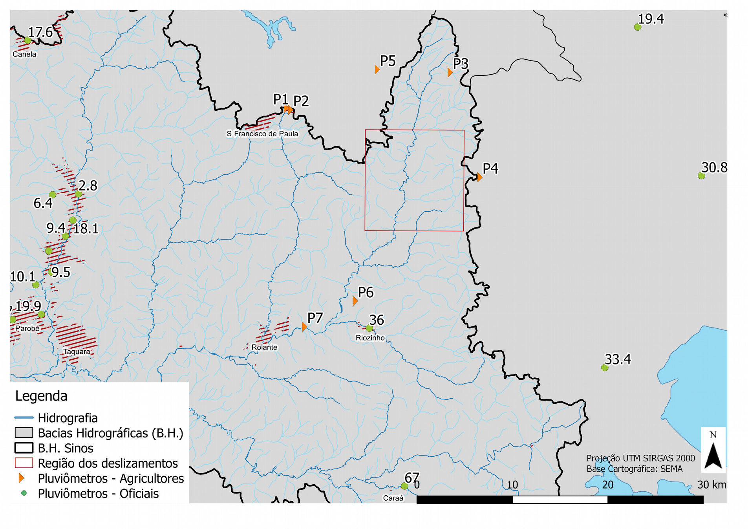
Point | Rainfall (mm)
P1 | 110
P2 | 180
P3 | 130
P4 | 272
P5 | 100
P6 | 90
P7 | 96
Localities of the official monitoring station (rain in mm) and of the rainfall measuring points by farmers (SEMA-GPDEN, 2017).

Slide 15
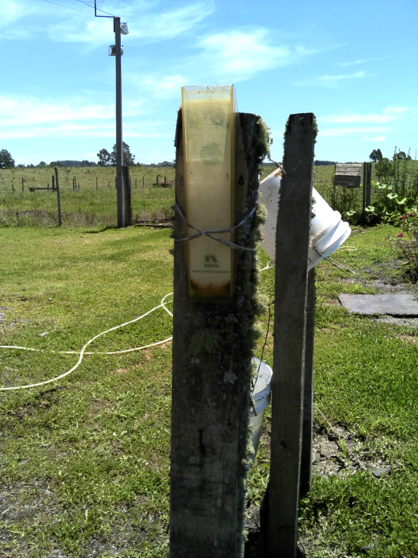
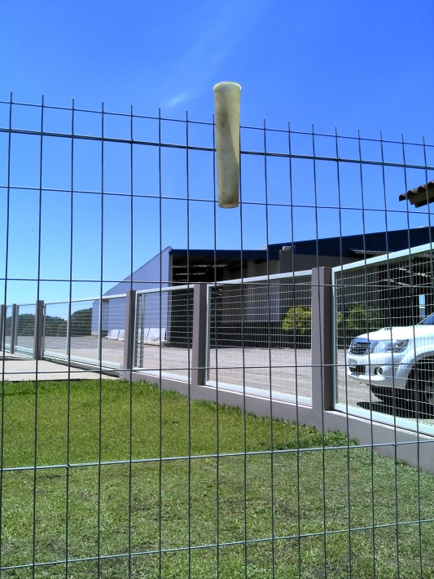
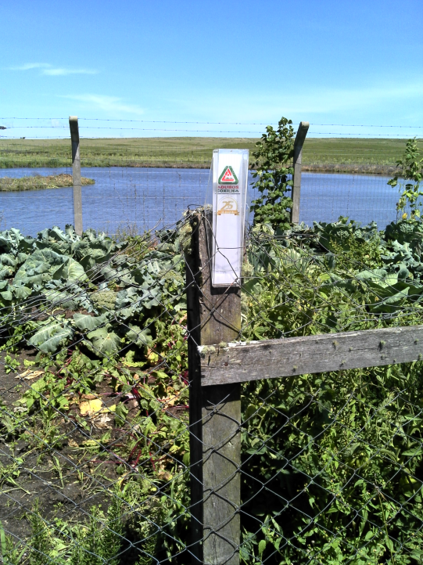
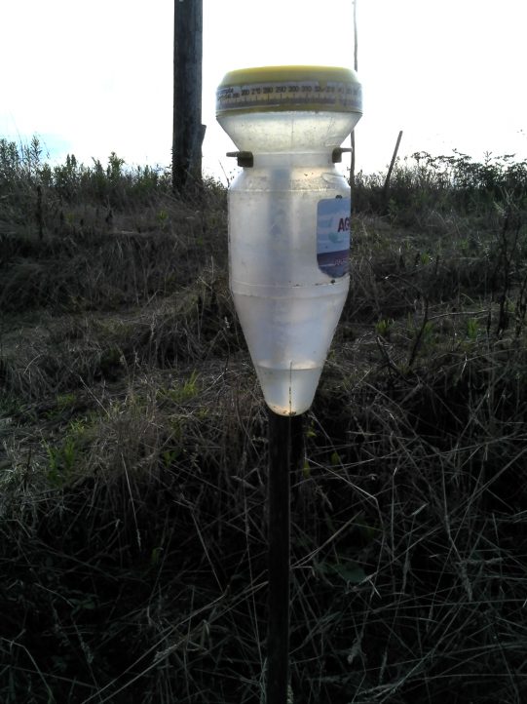
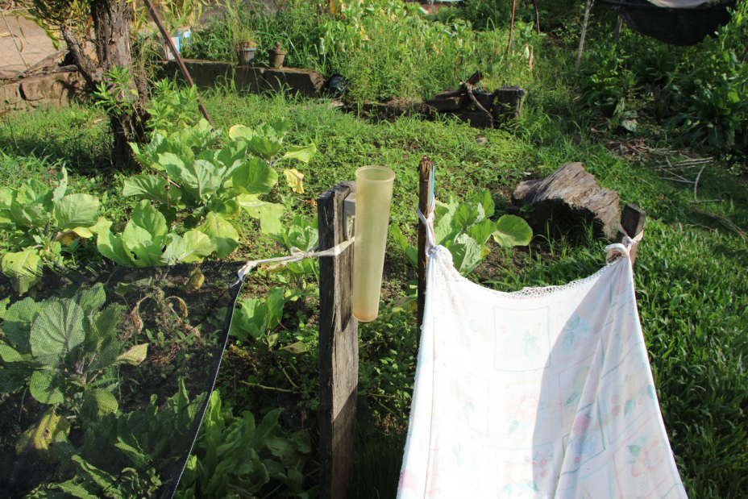
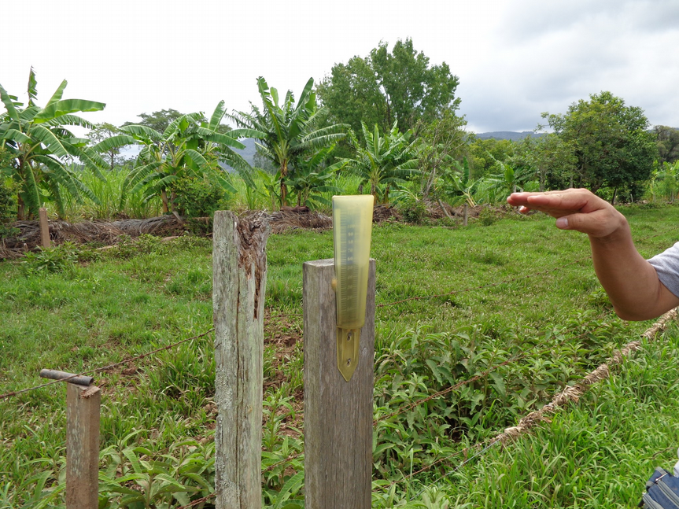
P1
P2
P3
P5
P6
P7

Slide 16
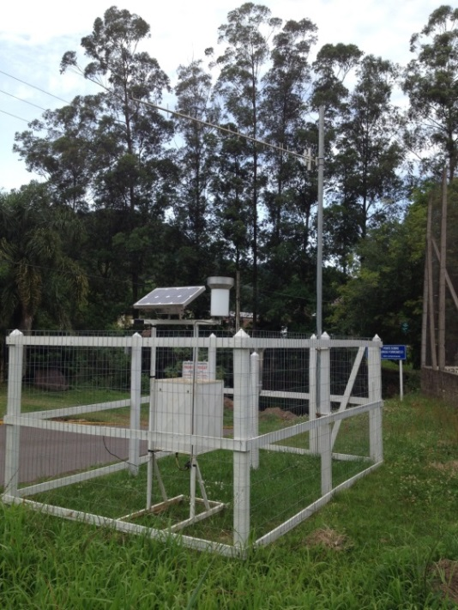
It is very difficult and complicated to carry out scientific studies and preventive measures for reducing hydrological disasters with the actual number of rainfall gauge and discharge stations.
A citizen science is strongly desired!

Slide 17
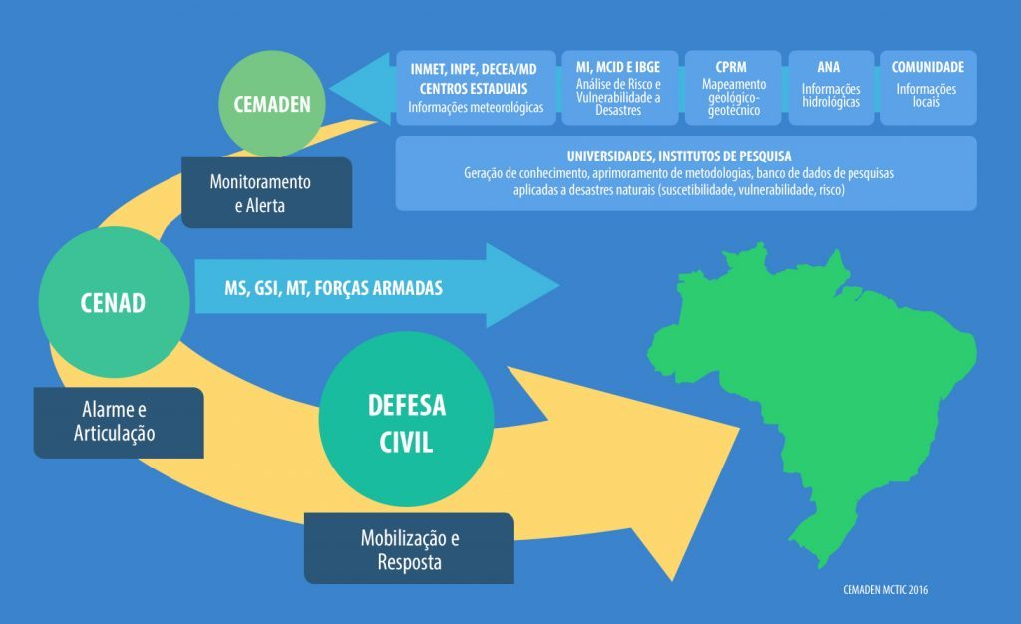
2.3. Slow action at federal government level
CENAD (Centro Nacional de Gerenciamento de Riscos e Desastres)
CEMADEN (Centro Nacional de Monitoramento e Alertas de Desastres Naturais)
Too much time!

Slide 18
For (slow) floods, the current system with CEMADEN + CENAD can be useful. But for flash floods and debris flows, the current system does not work well because of its slowness.
The decentralization of the current system is required.
Transfer to state governments, municipalities or
committees of river basins.

Slide 19
2.4. Lack of training courses and environmental education
Principle: Each citizen has to save his life.
The training courses and environmental education are required.
Science and technology for all the citizens (Citizen science establishment)
Integration of universities with governments, Civil Protection, schools, etc.

Slide 20
2.5. Data-base (maps, registers, history, etc.)
The quantity of data of floods occurrences is not so much.
landslides occurrences
rainfall
discharge
damages
etc.
We do not have much information to discuss the landscape evolution.
It is difficult to calibrate and validate the landscape evolution models and climate change models.

Slide 21
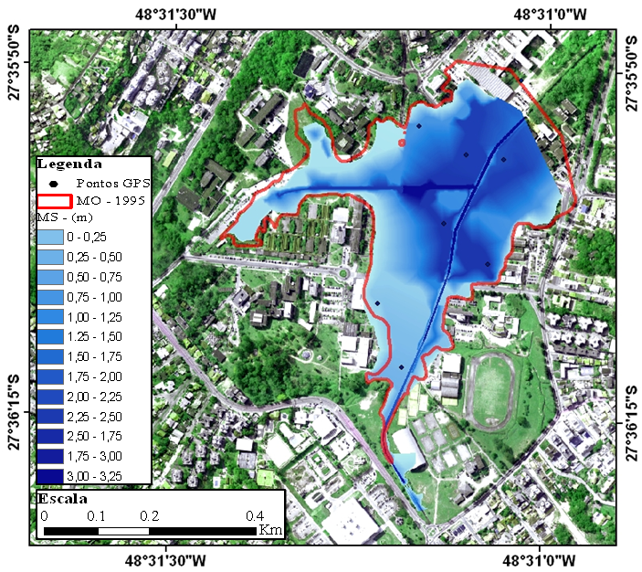
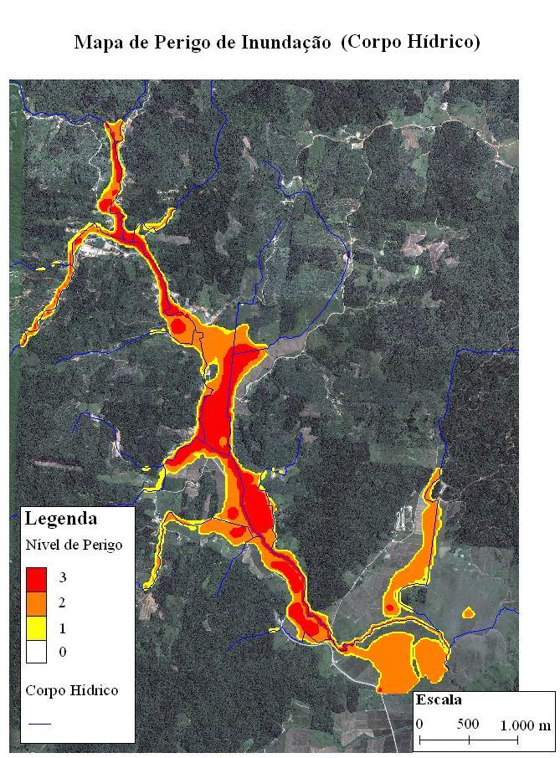
1995-Flood area observed in 2009 and simulated with HEC-RAS, in UFSC campus catchment (Florianópolis – SC)
2008-Flood area simulated with Flo-2D, in Baú region (Ilhota – SC)

Slide 22
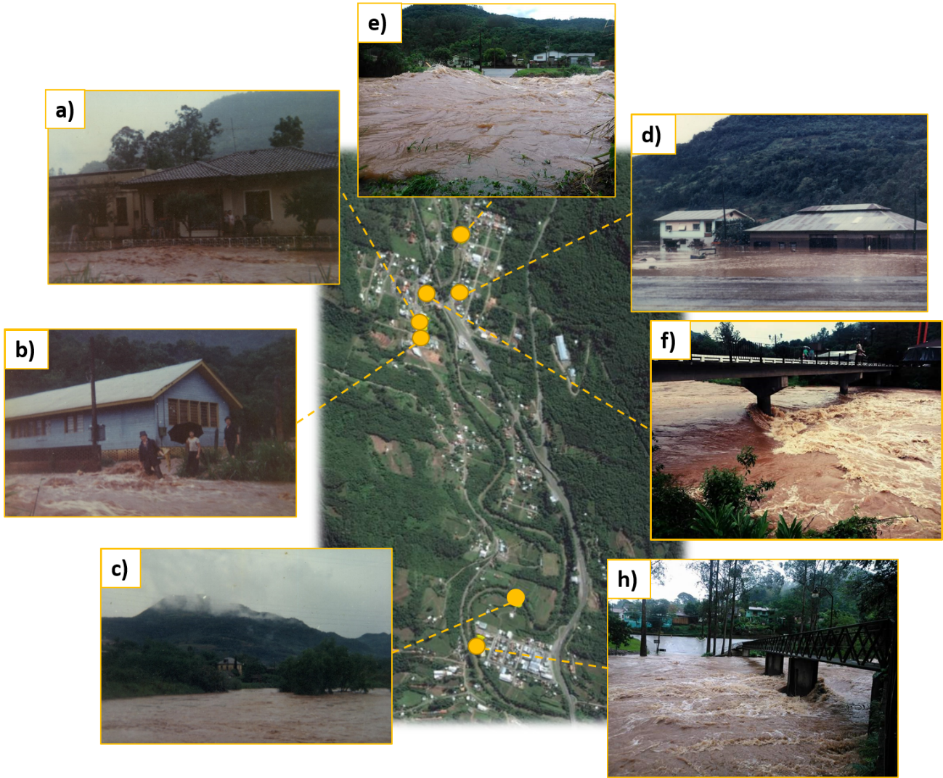
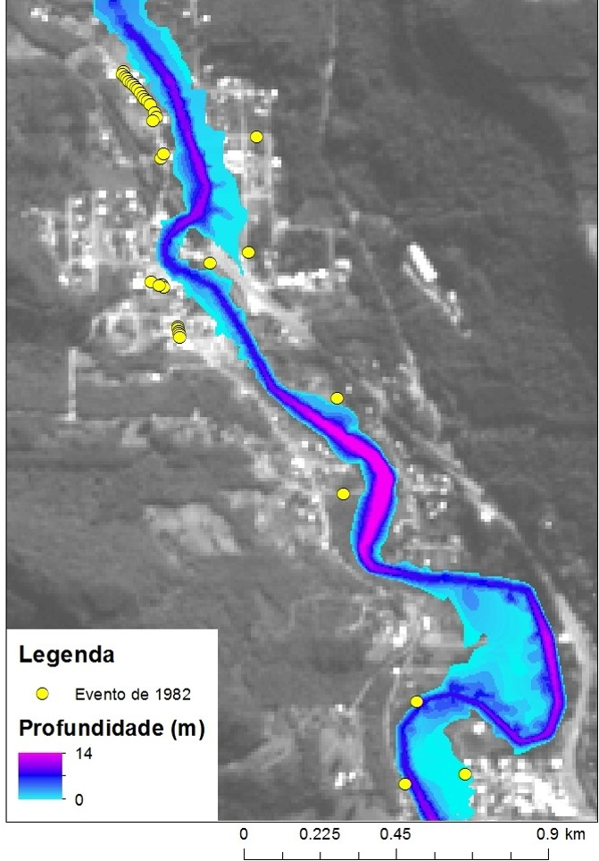
Records of flood in 1982 and 2015

Slide 23
3. Suggestions for investment to reduce water-related disaster
Creation of DEM with 1:10,000 (or 2 m) and its availability.
Construction of many monitoring stations of rainfall and discharge, especially for small catchments (< 50 km²).
Decentralization of the current systems of monitoring and alert (transfer from federal to state and municipal governments).
Providing training and education to strengthen and empower all citizens.
Construction of database and its availability
Important role of citizens
Necessity to improve human resources
Citizen Science establishment

Slide 24
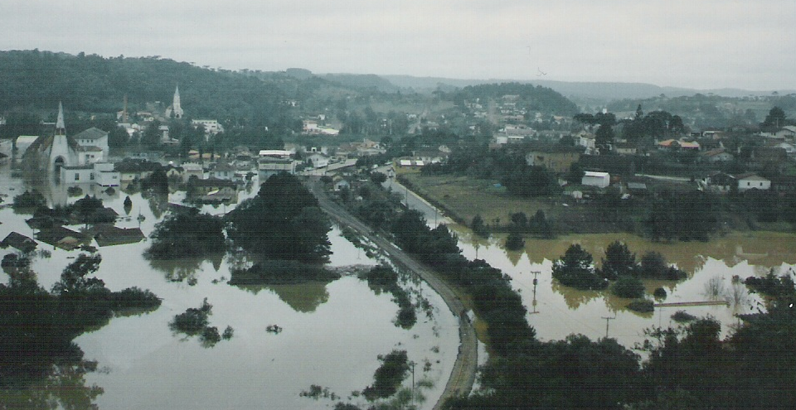

4. Final considerations
Importance of education to all the citizens.
Importance of citizen science.
Importance of history (registers)
Water education (Hydrology education) –
6th theme of IHP-VIII Phase (Water Security)

Slide 25

Masato Kobiyama – masato.kobiyama@ufrgs.br
Grupo de Pesquisa de Desastres Naturais (GPDEN) – www.ufrgs.br/gpden
Thank you very much!

