Slide 1


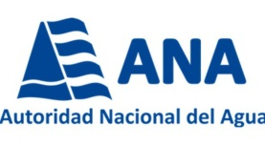









MMVSE
Water, Climate and Development Programme-WACDEP
“Improves the cross-sectoral interaction for building resilience to climate change and water security in the sub-basin of Santa Eulalia”
19 may ,2016
Workshop "Sustainable and Resilient Municipalities" ( Mdeo , 16-20 May)
Lucía Matteo
Regional Coordinator
GWP Sudamérica

Slide 2

The Water, Climate and Development Programme: WACDEP
It is part of a global initiative promoted by GWP in South America
Created to support the integration of water security and adaptation to climate change in planning processes for sustainable development , promoting Integrated Water Resources Management ( IWRM) as a key strategy .
It is estimated that the direct beneficiaries will be about 15,000 people , of which almost 7,000 are living in poverty.
Programme open to all organizations who wish to contribute technically or financially .

Slide 3
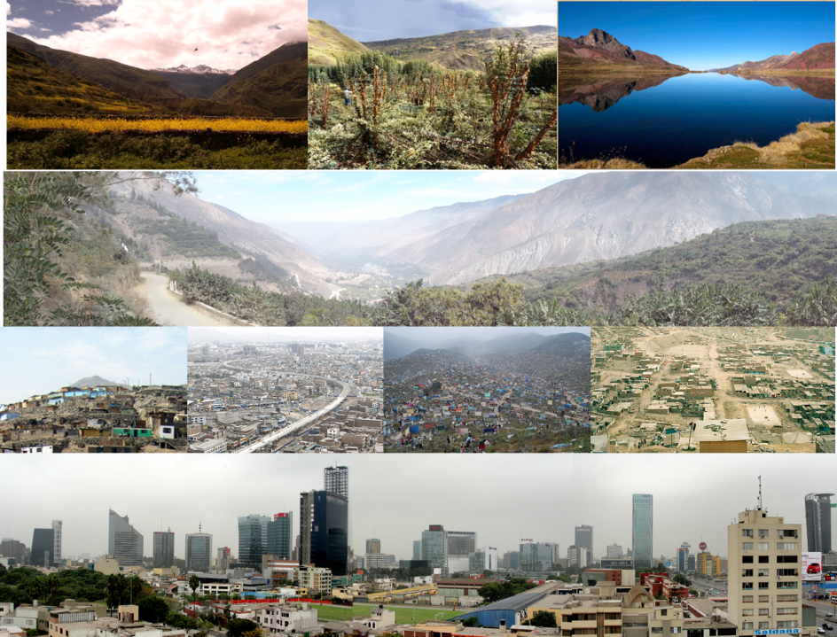
The site choice:
The sub-basin of Santa Eulalia River

Slide 4
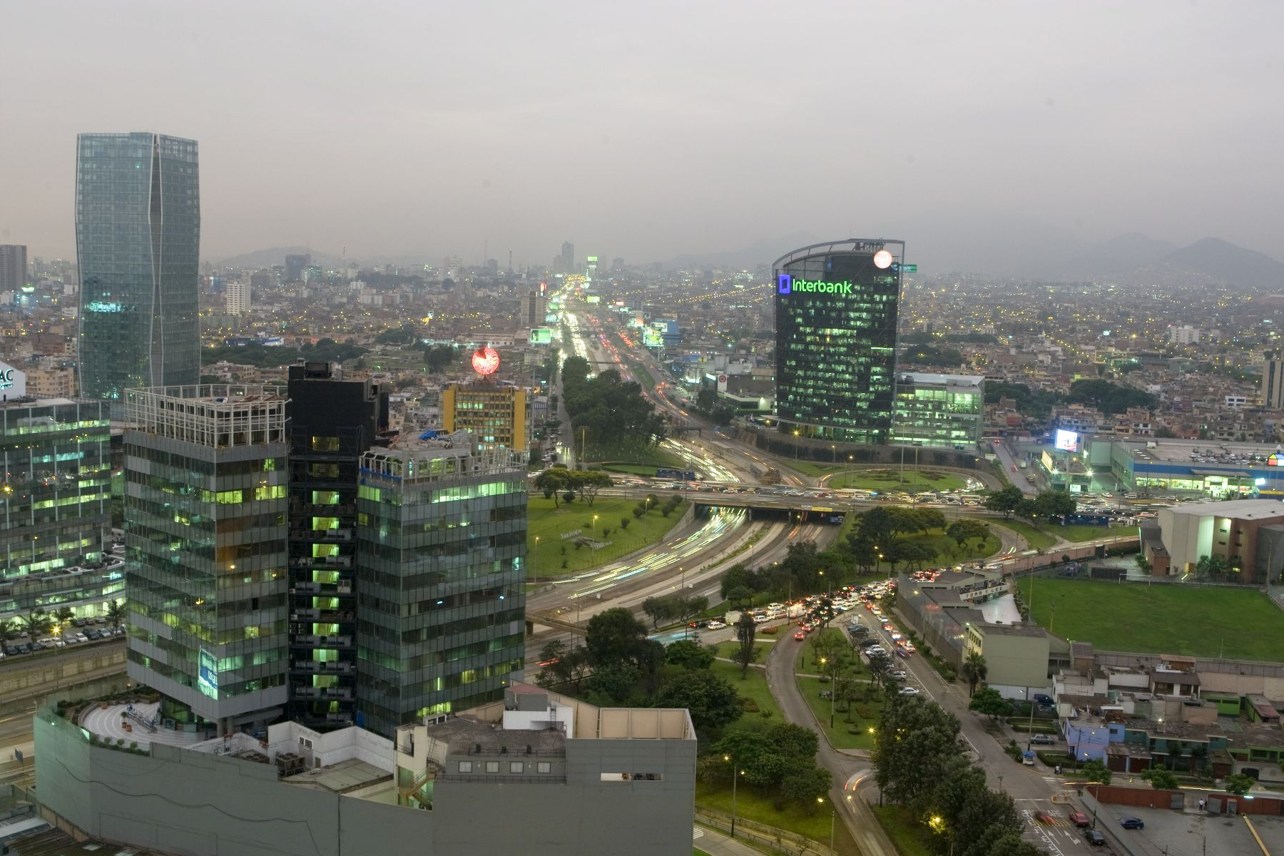
Lima and Callao population 2013
Lima :
Largest city of Peru (1/3 of the population)
Strong population growth
Increasing demand for energy , water and food
Annual growth rate of Lime population
Projection of population growth of Lima and Callao

Slide 5
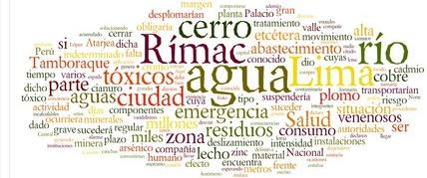
Santa Eulalia sub-basin contributes over 50% of water and
70 % of energy used Lima

Slide 6
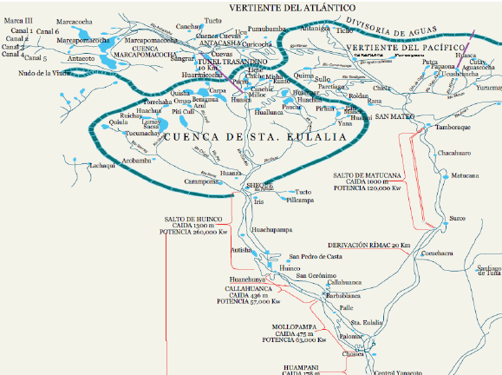
Santa Eulalia River main tributary of Rimac River

Slide 7
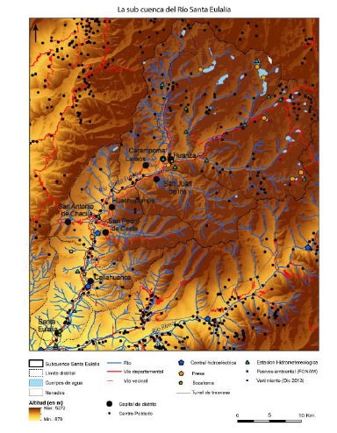
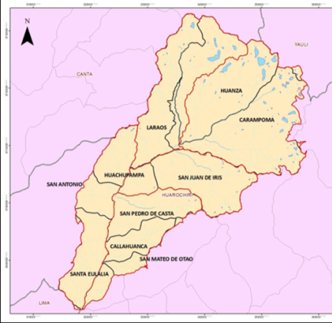
Total population: 33 985 inhabitants in 2015. 9 districts (municipalities):
District of Santa Eulalia (downstream) with 11787 inhabitants.
The other 8 districts upstream with 22198 inhabitants.

Slide 8
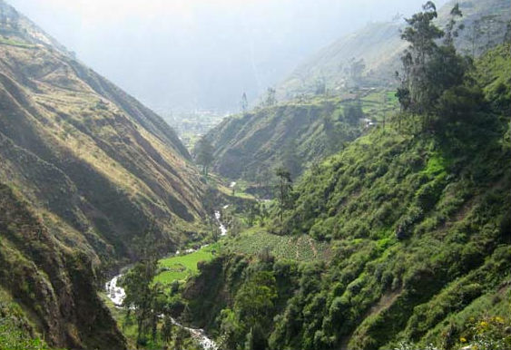
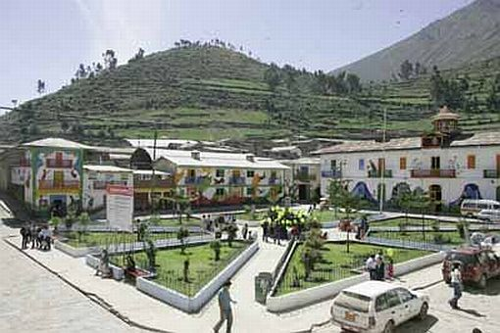
Santa Eulalia sub-basin:
Difficult accessibility
Extreme poverty: 10-20%
Several unmet needs
High illiteracy rate

Slide 9
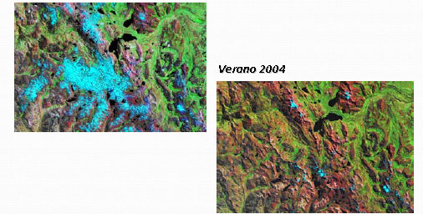
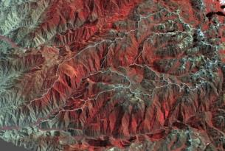

The glacier retreat in the Rimac basin is extremely strong , affecting climate change to the water flows, functioning of ecosystems, activities and human welfare.
Summer 2004
Summer 1999
.
Image of the sub-basin in 5.4.3 bands of Landsat 7 in 2009
Inventory 1970 |  | Inventory 2007 |  | Reduction in glacial surface (% )
Glaciers quantity | Glacial surface (Km²) | Glaciers quantity | Glacial surface (Km²)
17 | 7.08 | 9 | 3.17 | 55.23
Source: ANA, april 2004

Slide 10
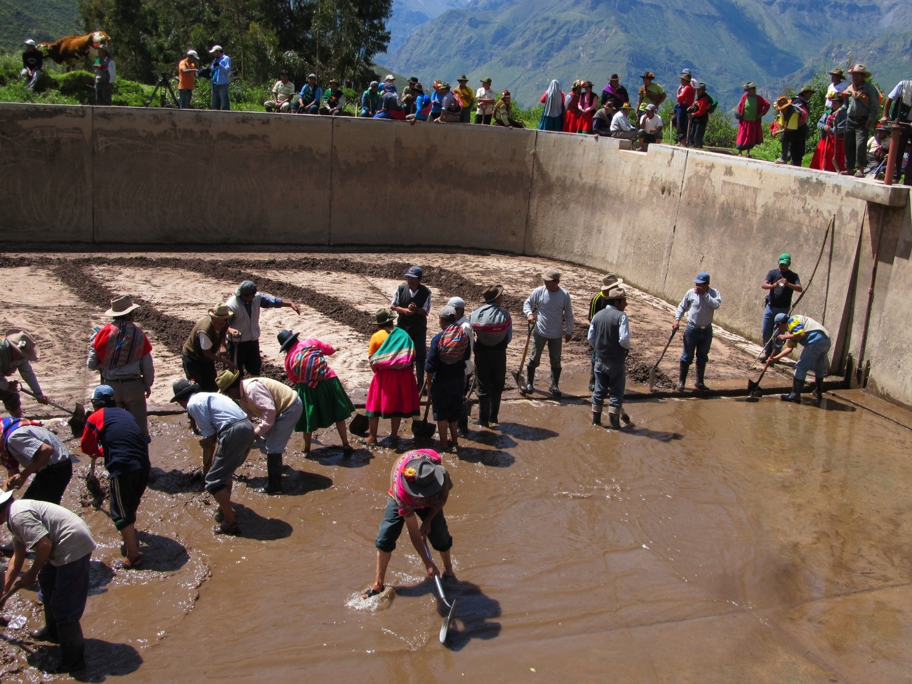
Main goal of the pilot programme
Contribute to better water governance, demonstrating that coordinated and cross-sector interaction is possible in practice as an effective strategy for achieving water security and build resilience to climate change for the population, vital ecosystems and sustainable socio-economic development.

Slide 12
Some expected results:
Water security and climate resilience are integrated into decision-making processes and development planning in the Santa Eulalia sub-basin.
Investments ' no/low regrets' ** to improve water management are identified and formulated and funding agencies are committed to support these initiatives.
The governance and the interinstitutional coordination is improved to bulid climate resilient management models in the sub-basin of Santa Eulalia and in the Metropolitan region of Lima.
It manages to capture greater flows of financing for the development of actions that promote climate resilience and contribute to water security and sustainability of the sub-basin of Santa Eulalia and the metropolitan region of Lima.
**In the context of the Water and Climate programme in South America, the term "investments no / low regrets" refers to measures to be taken even in the absence of the negative effects of climate change

Slide 13
Some expected results:
Santa Eulalia sub-basin actors implement 'green' and innovative solutions to face challenges of water security such as the supply of drinking water, food and energy to address climate change in communities.
A better understanding of the approach of IWRM as a key strategy for adaptation to climate change and economic development is reached and increases the involvement and commitment of stakeholders responsible for developing actions oriented towards an adaptive and efficient water management to climate change.
Coordination and work of GWP network with partners and stakeholders is strengthened to integrate water security and climate resilience in sustainable development processes.

Slide 14
WACDEP Stages
Commitments for public/private entities for the creation of WACDEP
Second stage: implementation of different areas: baseline, identification of demonstration projects/ technical files and governance process, etc ...
First stage : elaboration of WPCDEP, first participatory diagnosis , stakeholder mapping and awareness
2015
2014
2013

Slide 15
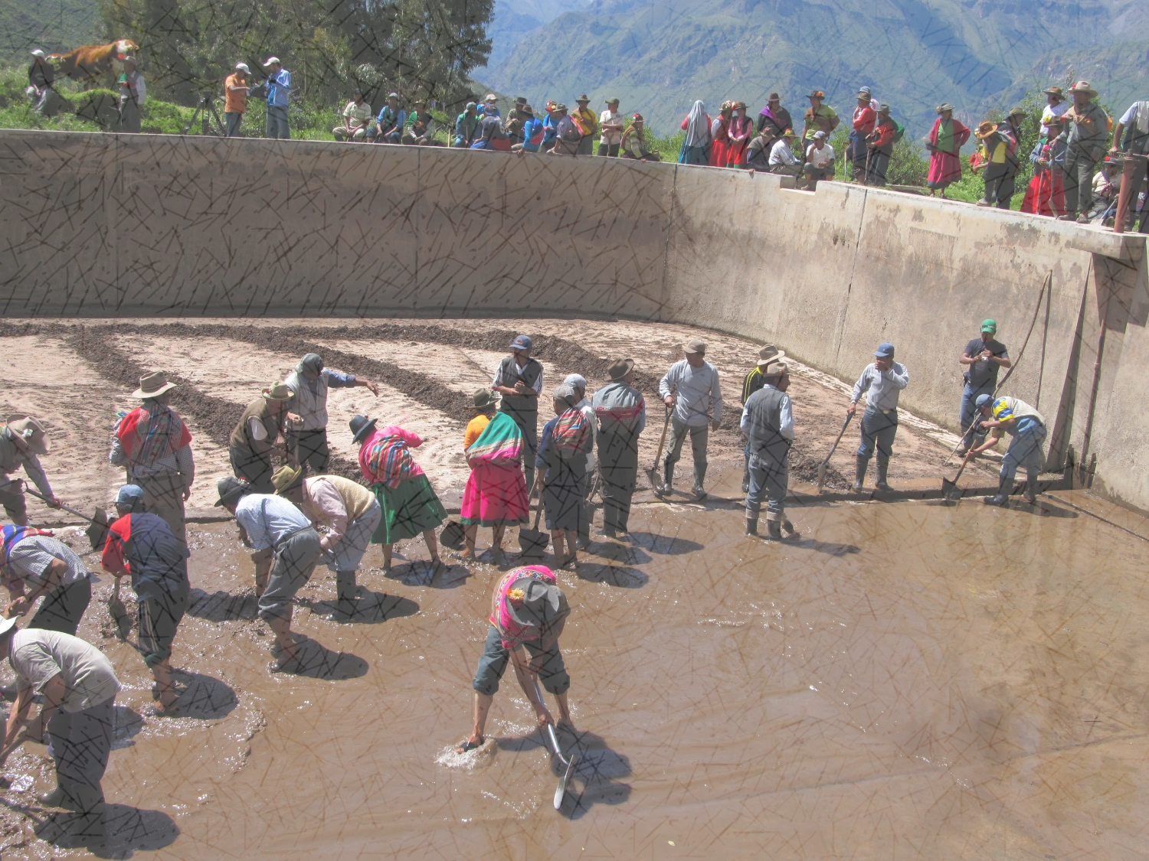
Three main lines of work:
IWRM planning process
Rapprochement between municipalities and communities
Payment for ecosystem services

Slide 16
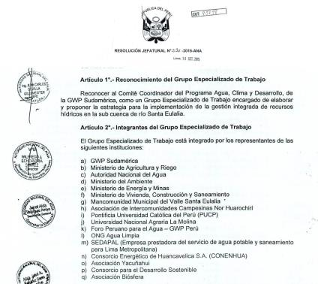
IWRM planning process
September 2015
Formal recognition of WACDEP Committee
by ANA
Has given this initiative , originally from GWP, a "shared institutionality " , has improved ownership and the possibilities of sustainability of the actions in this sub-basin in the future.

Slide 17
WACDEP Committee is integrated by:
Ministry of Agriculture and Irrigation
Ministry of Environment and Energy
Ministry of Energy and Mines
Ministry of Housing, Construction and Sanitation
National Water Authority ( ANA )
SEDAPAL ( service company providing water and sanitation for metropolitan Lima)
Pontifical Catholic University of Peru (PUCP )
University Agraria La Molina ; Municipal Commonwealth of Santa Eulalia valley.
Association of Rural Communities Nor Huarochirí
NGO Clean Water ; Consortium for Sustainable Development
Biosphere Association ; Yacuñahui Association
Energy Consortium of Huancavelica ( CONENHUA S.A. )
GWP Peru and South America
  Soon will be expanded to include:
  Geological Mining and Metallurgical Institute ( INGEMMET )
  National Superintendence of Sanitation Services (SUNASS )
  Institute for Development and Environment ( IDMA )
  Aquafondo
  The Nature Conservancy

Slide 18
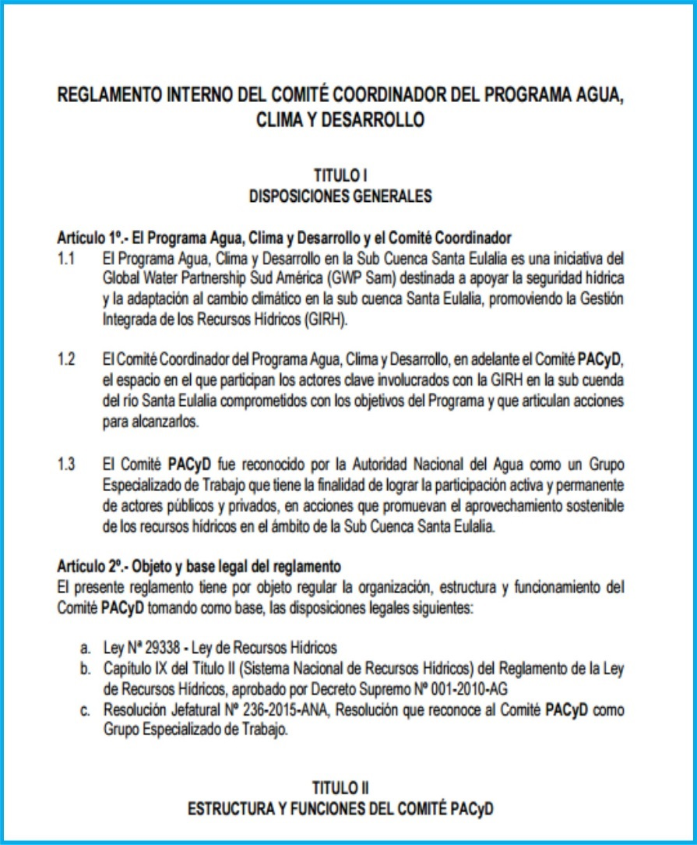
April 2016
Internal regulation of WACDEP Committee approved
important institutional step to guide and ensure sustainability to the program actions
Among its features :
Develop the strategy for the implementation of IWRM in the sub – basin
Contribute financially or in-kind support and fundraising
Promote the inclusion of the Strategy referred in the IWRM plan of the Rimac Lurin Chillón basin.

Slide 19
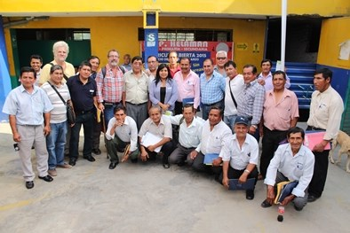
2. Rapprochement between municipalities and communities
February 2015
Mayor and rural communities signed an unpreedented letter of commitment
Municipalities commonwealth (8 district mayors ) and intercommunity Association (presidents of peasant communities )
Commitment to coordinate actions to address the needs and priority issues for the development of the sub basin → defined joint actions
first time they dialogued ! This brings the needs of farmers to the possibilities of financing through the municipalities (access to government programs ) → development training proposals
Notes:
He eliminado los nombres porque ocupan espacio y lo que le importa a la gente es entender el tipo de organización involucrada

Slide 20
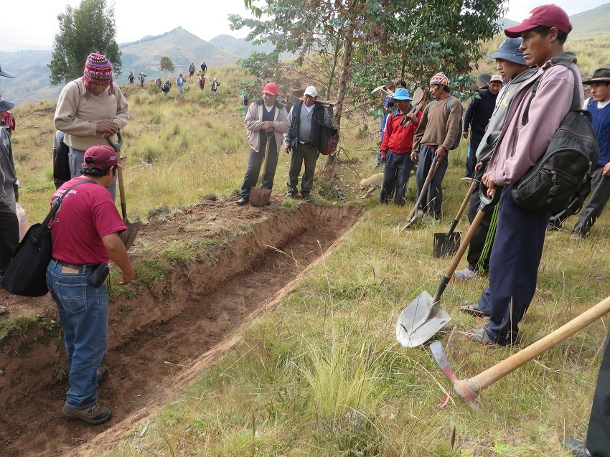
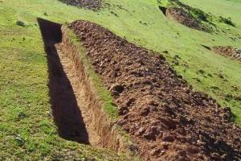
Payment for ecosystem services
Pilot project of infiltration trenches
hydrogeological Inspection (INGEMMET )
Water nexus Analysis, food , energy and ecosystems ( KTH )
Notes:
SOCORRO, las dos diapositivas que tenías no son zanjas de infiltración!!! Las que he puesto son tomadas de internet pero pasan piola...

Slide 21
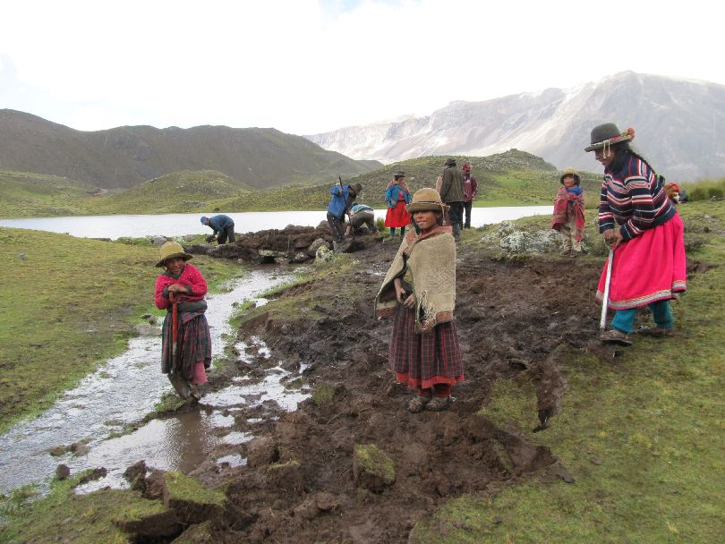
Thanks for your attention
lucia.matteo@gwpsudamerica.org

