Slide 1
GWP IWRM ToolBox:
Case Studies

Slide 2
What are Case Studies?
The IWRM ToolBox consists of knowledge (how to manage water) and learning (applying the knowledge):
Knowledge
Learning
60 Tools
References
Case Studies
the key concepts that have to be addressed in managing water
technical papers to training manuals to research documents to articles – an array of resources linked to specific Tools and Case Studies
show how the Tools work in real experiences from all over the world. They include successes and failures and share best practices.

Slide 3
What are Case Studies?
Implement IWRM
Critically examine real events and practical experience
LEARN

Slide 4
Who are the Case Studies For?
Those who apply IWRM:
trainers
capacity-builders
practitioners
decision-makers
academia and researchers

Slide 5
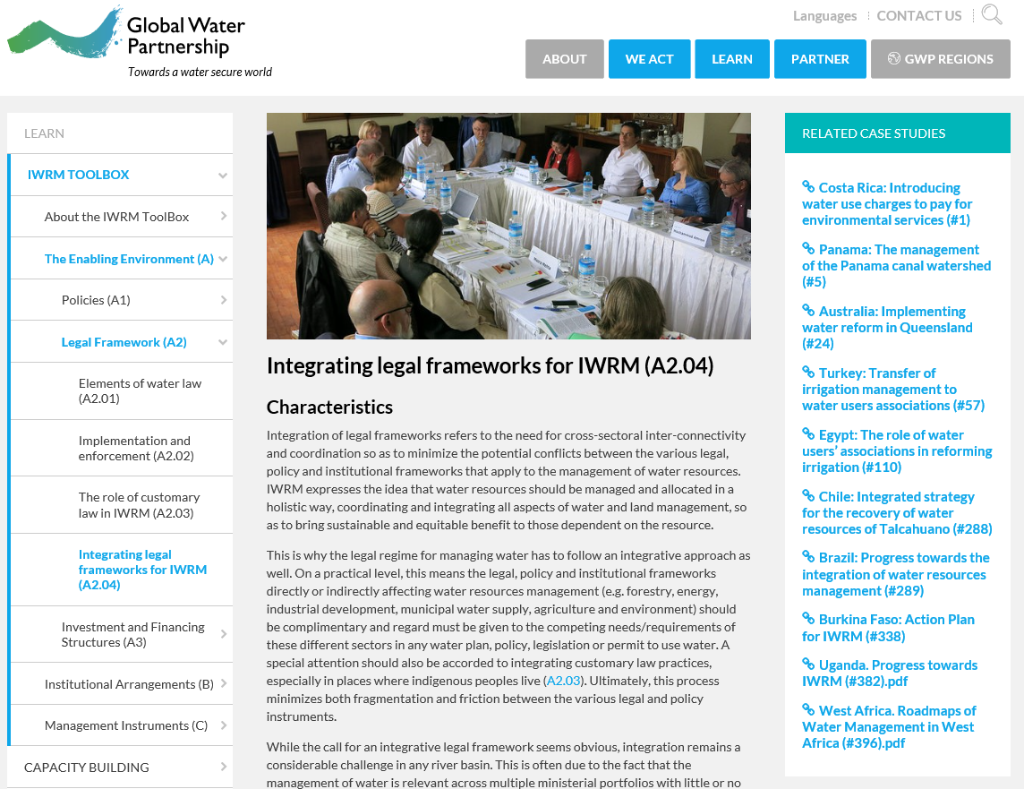
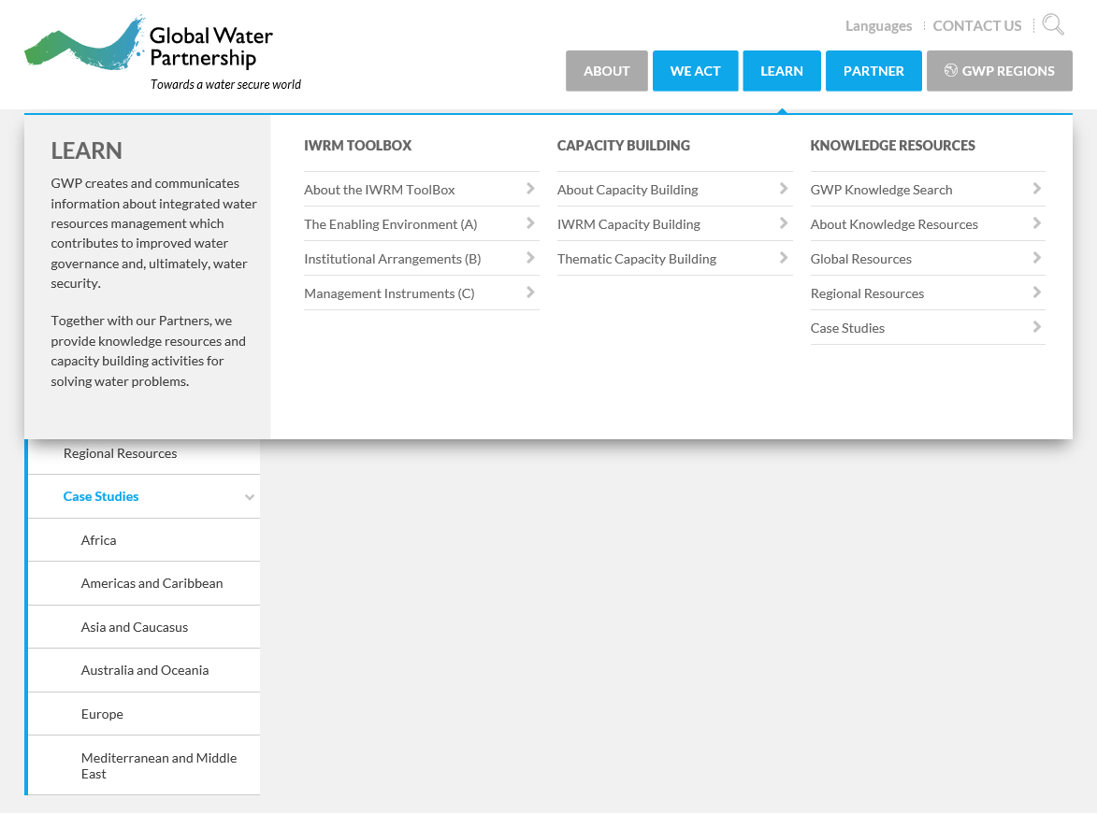
Case Studies in the ToolBox
Though the case studies are not explicitly within the IWRM Toolbox, each Tool has related case studies:
Case studies can also be accessed through Learn under Knowledge Resources, and are arranged into continents/regions:

Slide 6
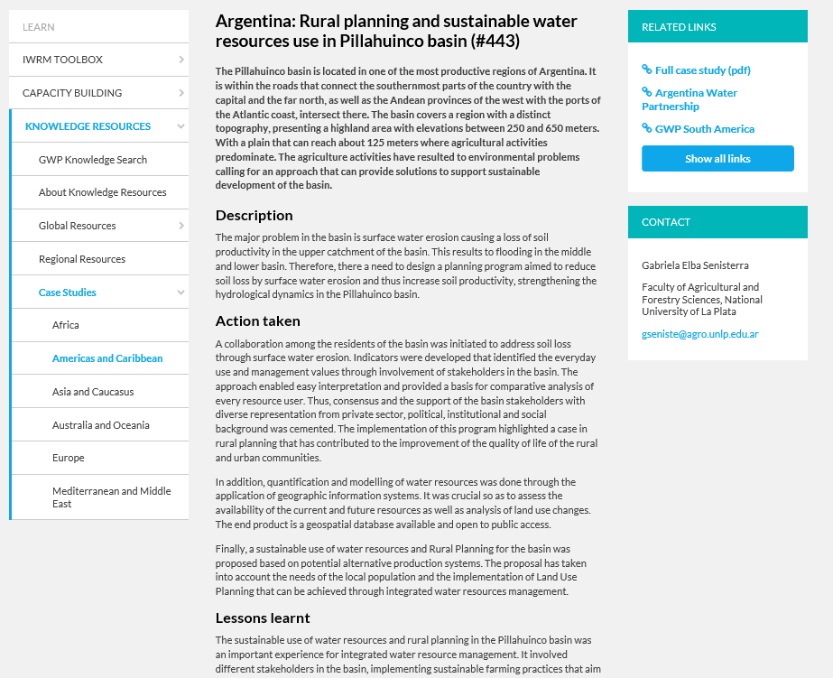
Case Studies in the ToolBox: an example
Each Case Study has:
Link to the full length case study (8-10 pages)
Contact information to learn more
1 page summary

Slide 7
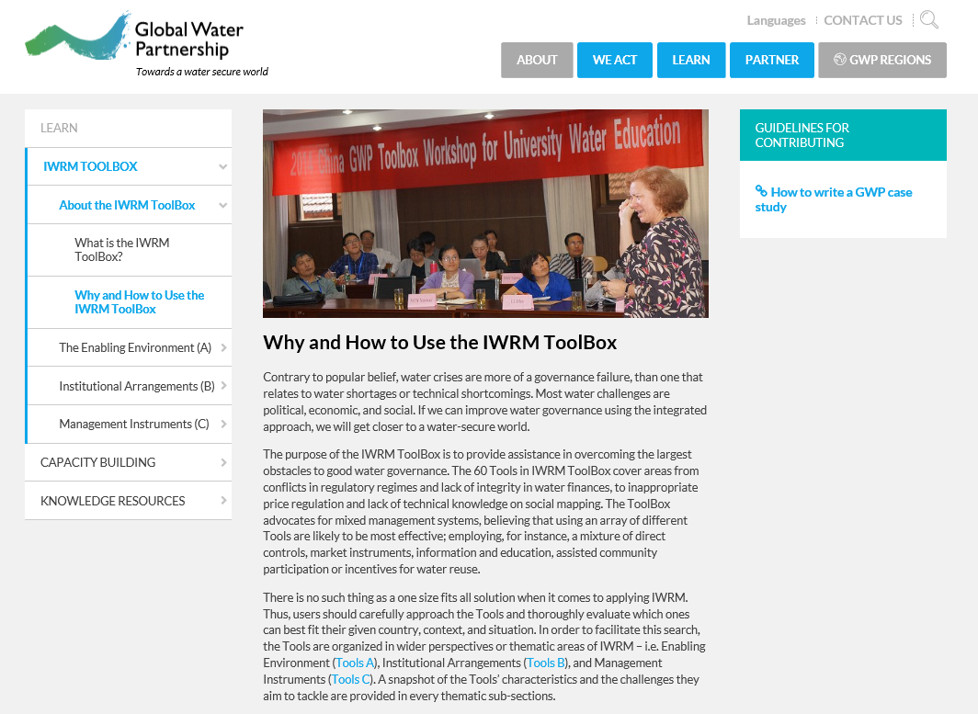
Case Studies in the ToolBox: Contributing
Do you have a case study to contribute?
Check out the guidelines
Submit a proposal!

Slide 8
Case Study Criteria
Case studies should | Case studies are not
Illustrate the application of tools shown in the ToolBox Be relevant to IWRM – with lessons about how an IWRM approach supports water management across sectors Reflect both successes and failures Address main issues of concern to the water community Be applicable to a wide audience | Based on theory rather than practice Academic Subjective

Slide 9
Case Study Format
Description of the Problem
Actions Taken
Key Outcomes
Lessons Learned
8-10 pages
Contact information

Slide 10
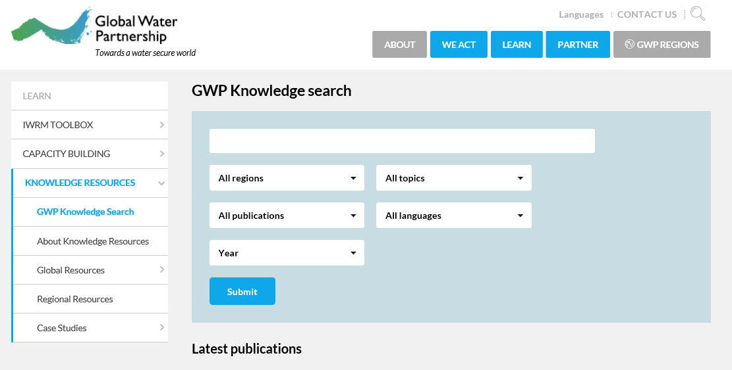
The GWP Knowledge Search
Looking for a case study on something specific?
Just choose
Case Study!
Search by:
Key words
Region (13 regions, or global)
Type of publication (16 options)
Year published (2000-now)
Topic (12 options)
Language (11 languages)

Slide 11
Thanks!
Questions? Contact gwp@gwp.org

